Slide 1
65-68
375C 40N 5min
Failed at 7N

Slide 2
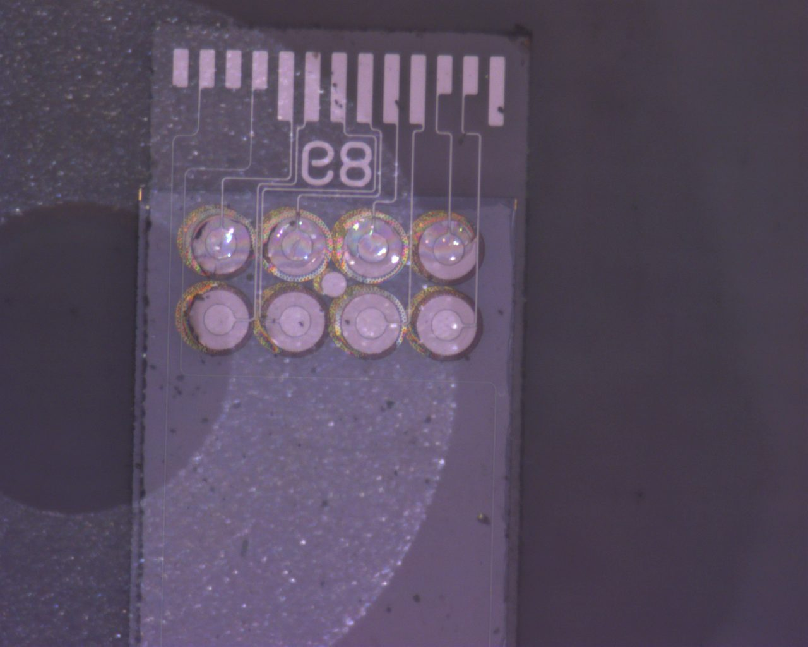
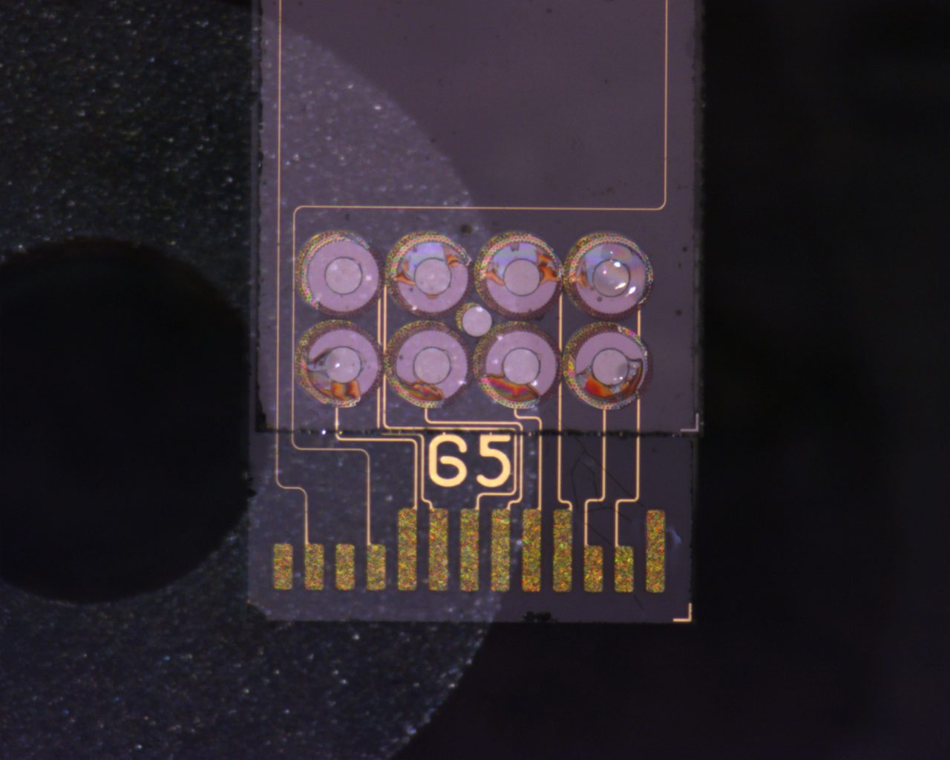
68 Nearside(Backside)
Pre Pull Test
Pad 1,2,3,4:
Definite formation of cracks beneath the pads, meaning glass is pre stressed.
Iridescence at edge of pads indicates delamination of gold from PECVD

Slide 3
68 Farside(Backside)
Pre Pull Test
Pad 5,6,7,8:
Definite formation of cracks beneath the pads, meaning glass is pre stressed.
Iridescence at edge of pads indicates delamination of PECVD from glass? Not Gold from PECVD?
Depends on the construction, if
Iridescence extends past the gold ‘dolly’ into the titanium adhesion layer

Slide 4
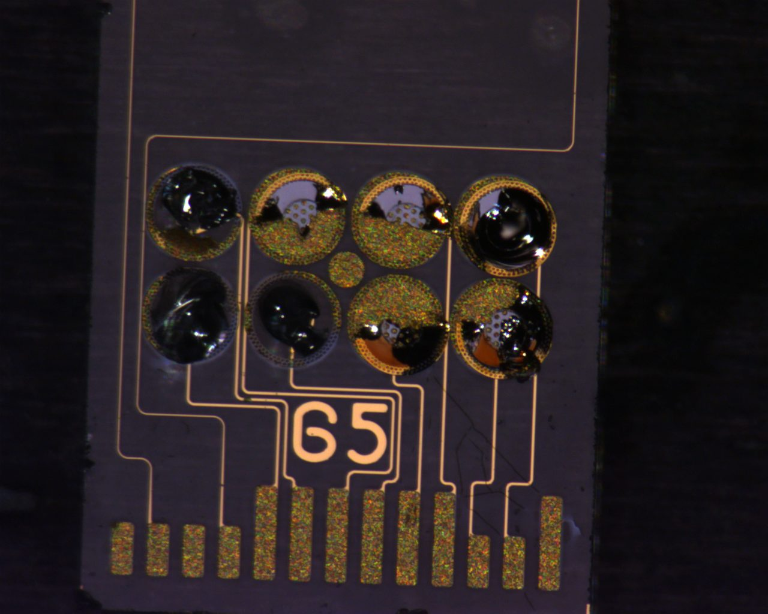
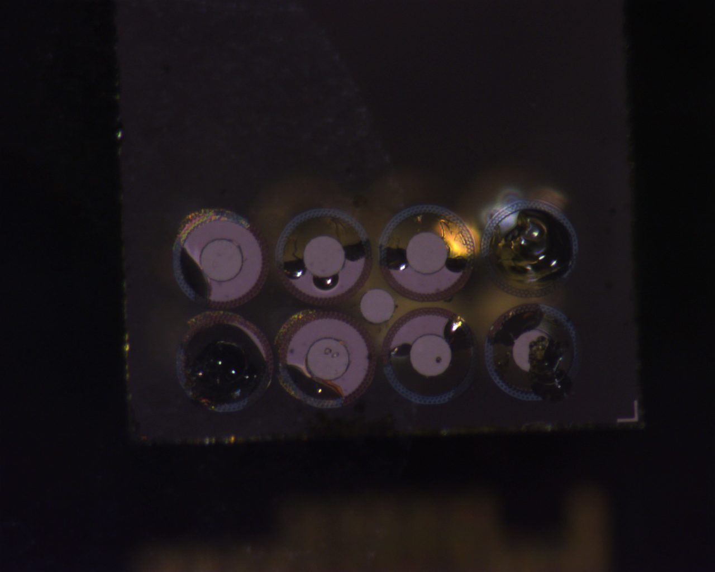
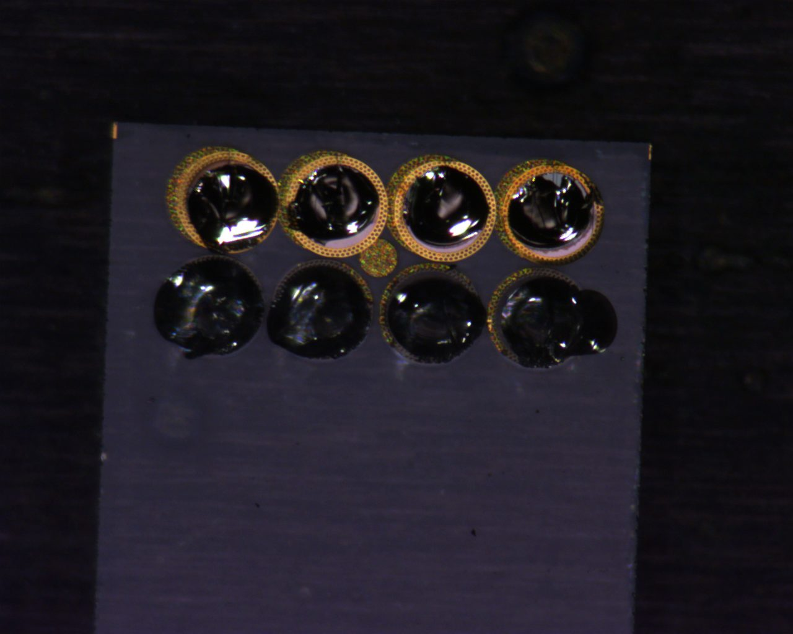

Slide 5
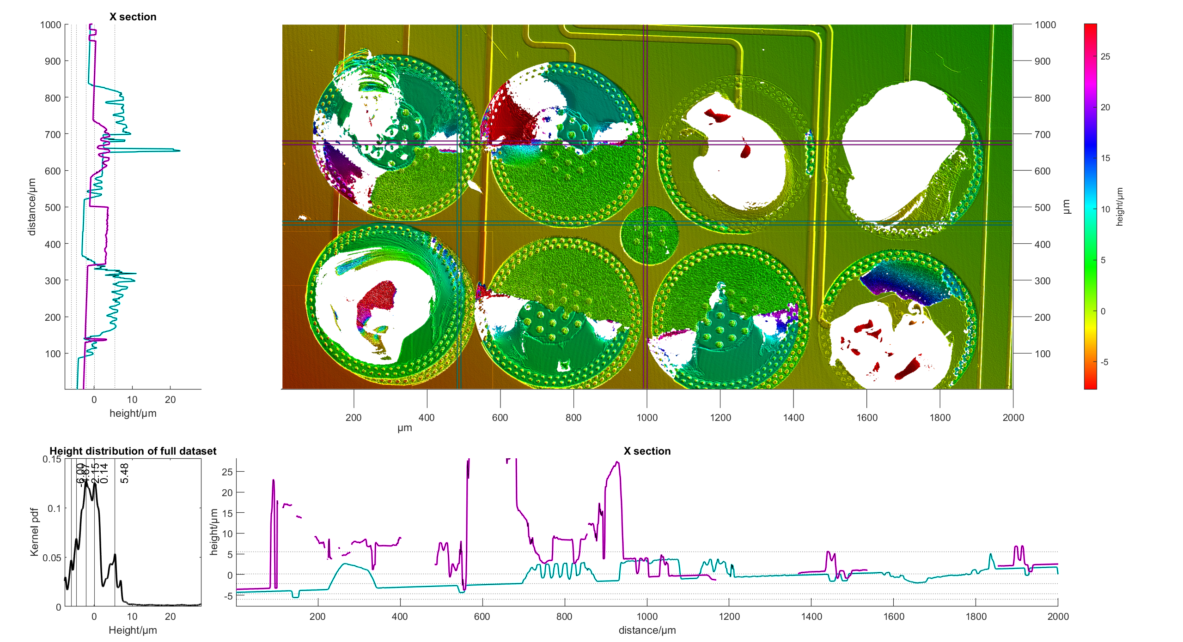
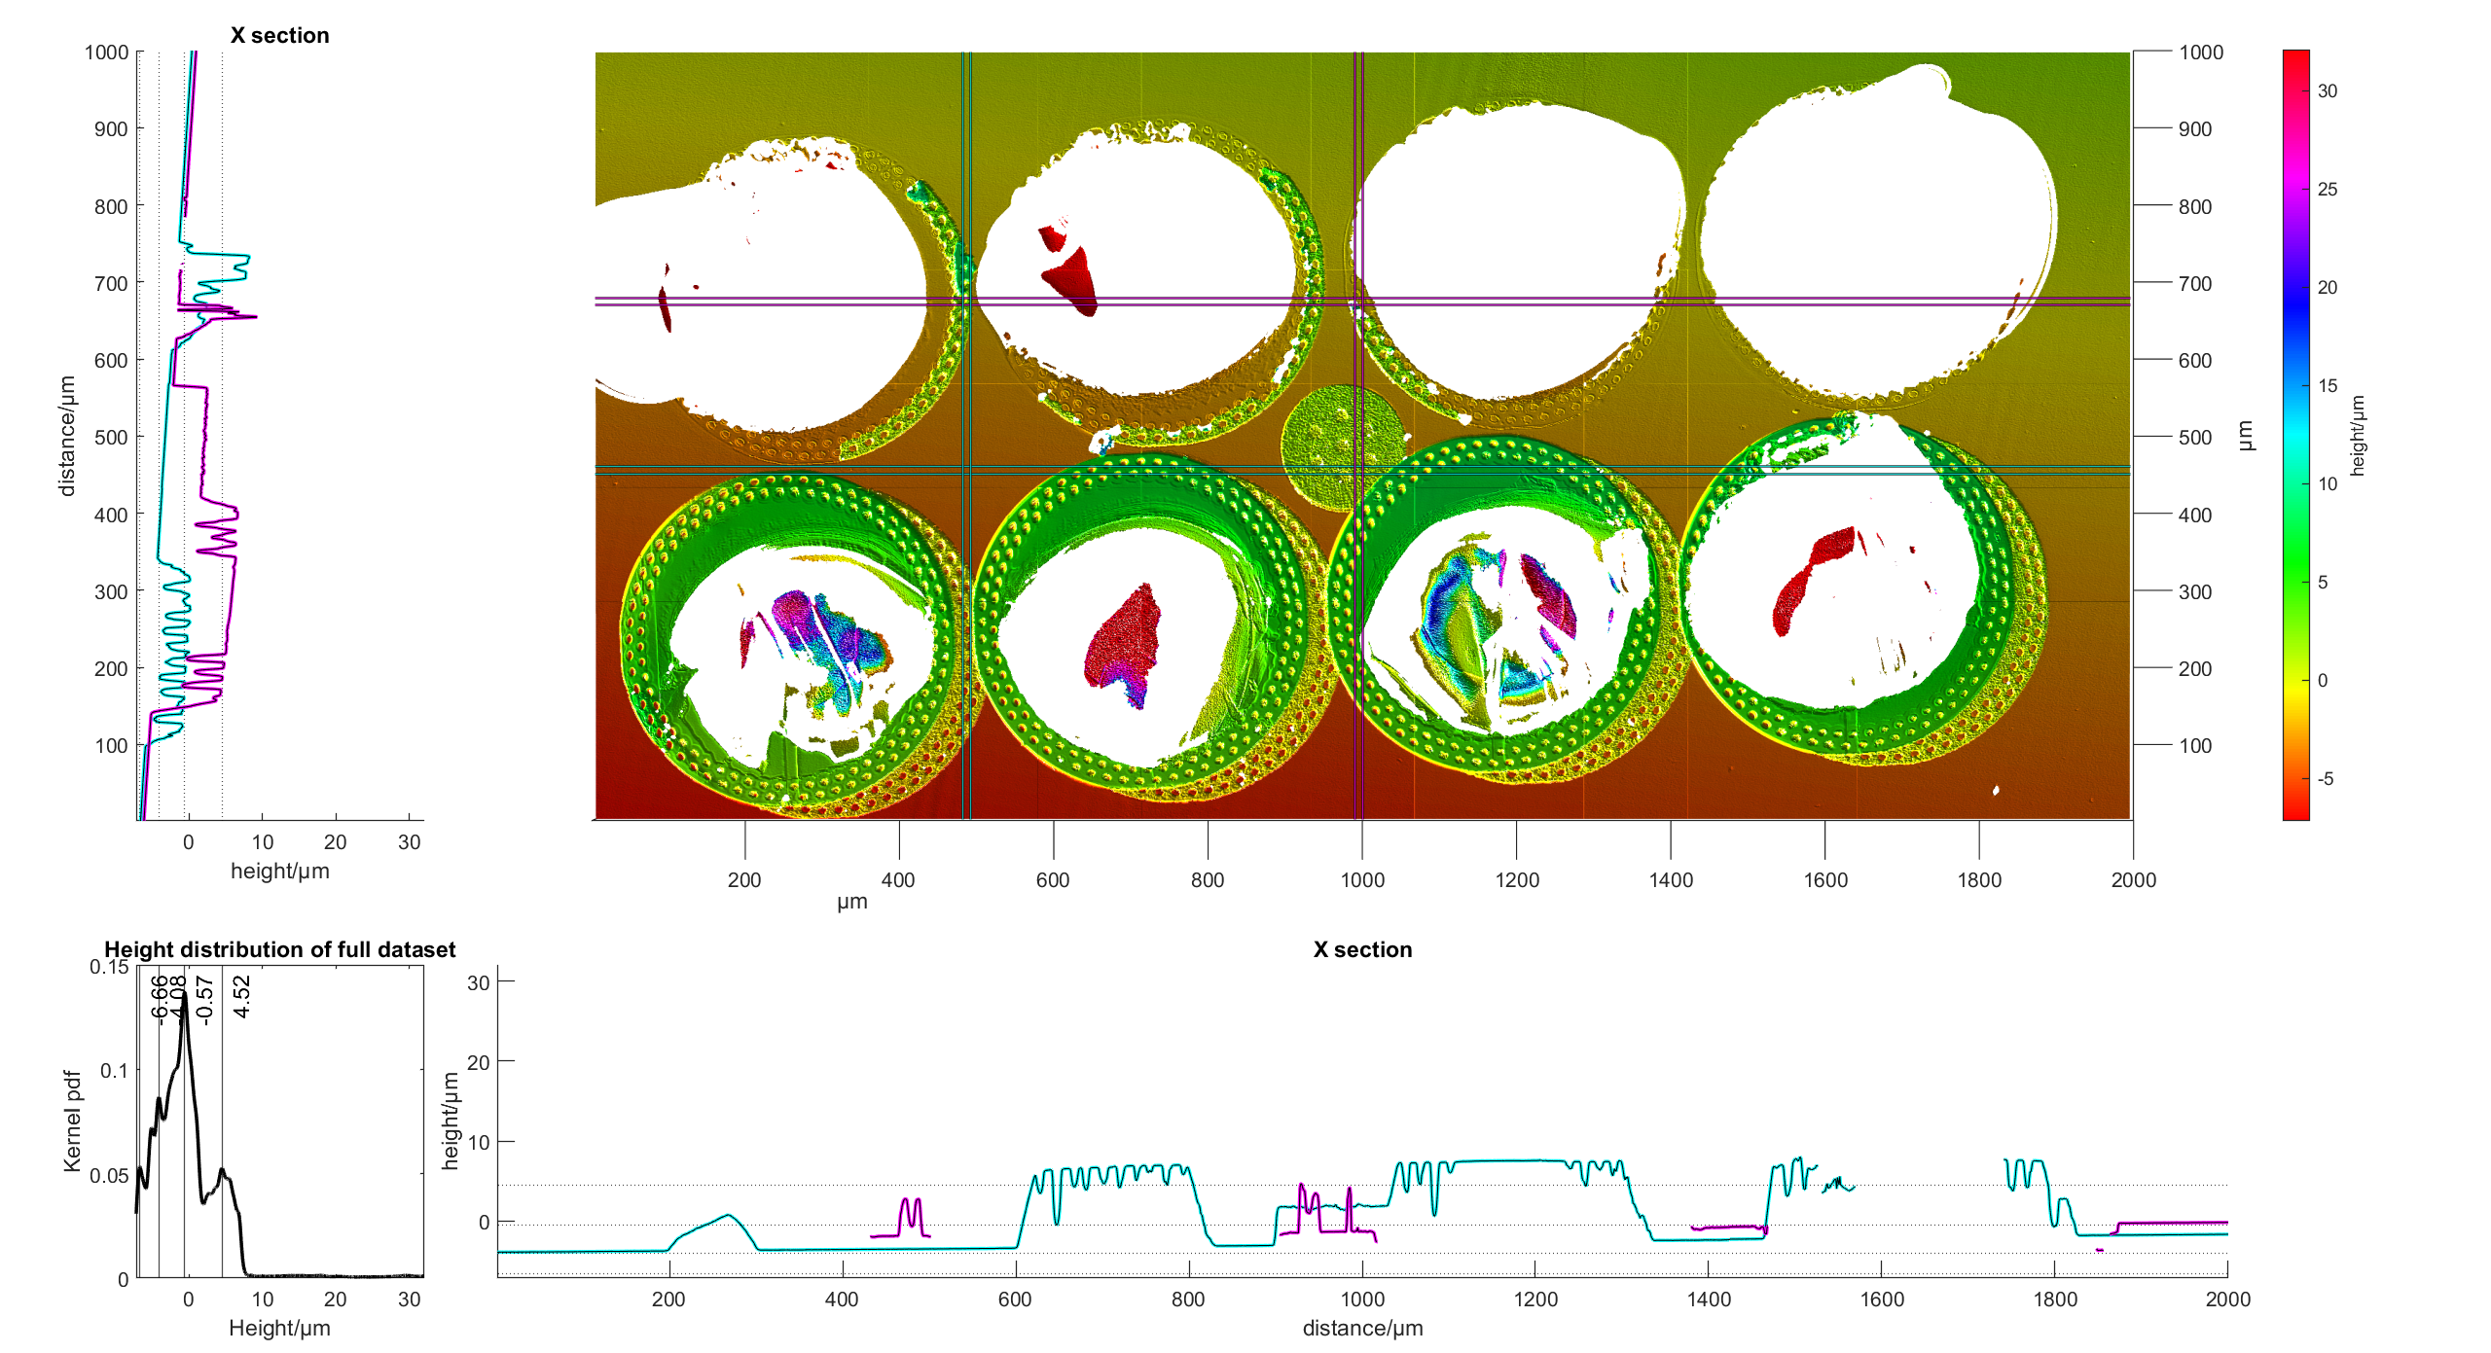
65 Nearside
Pad 1:
Partial pad failure, can see top half is raised approx. 5um from 65’s Pad.
Bottom half shows failure in the gold, where the pad peeled off, but final failure occurs from the pad on the other side. Gold-gold bond was as strong as the gold-titanium(?) bond. Corresponding pad on Strip 68 shows remainder of the pad.
Raised
From images: Difference in colour
Center is lower by 0.5um, and grey vs outside is brown and 05um higher.
This diff is due to the PECVD.
Means that center failure is further from glass than outer edge -> rules out brown area as gold-titanium failure??
Different failure plane for middle than for outer edge.
Outer edge failed at
Notes:
A72
Need to check between unbonded and compressed strip, whats the change in gold height.

Slide 6
65 Nearside
Pad 1:
Partial pad failure, can see top half is raised approx. 5um from 65’s Pad.
Bottom half shows failure in the gold, where the pad peeled off, but final failure occurs from the pad on the other side. Gold-gold bond was as strong as the gold-titanium(?) bond. Corresponding pad on Strip 68 shows remainder of the pad.
Raised portion rises to 29um, which comes from a combination of the peeling pad and presence of glass (compare with photos)
Notes:
A72
Need to check between unbonded and compressed strip, whats the change in gold height.

Slide 7
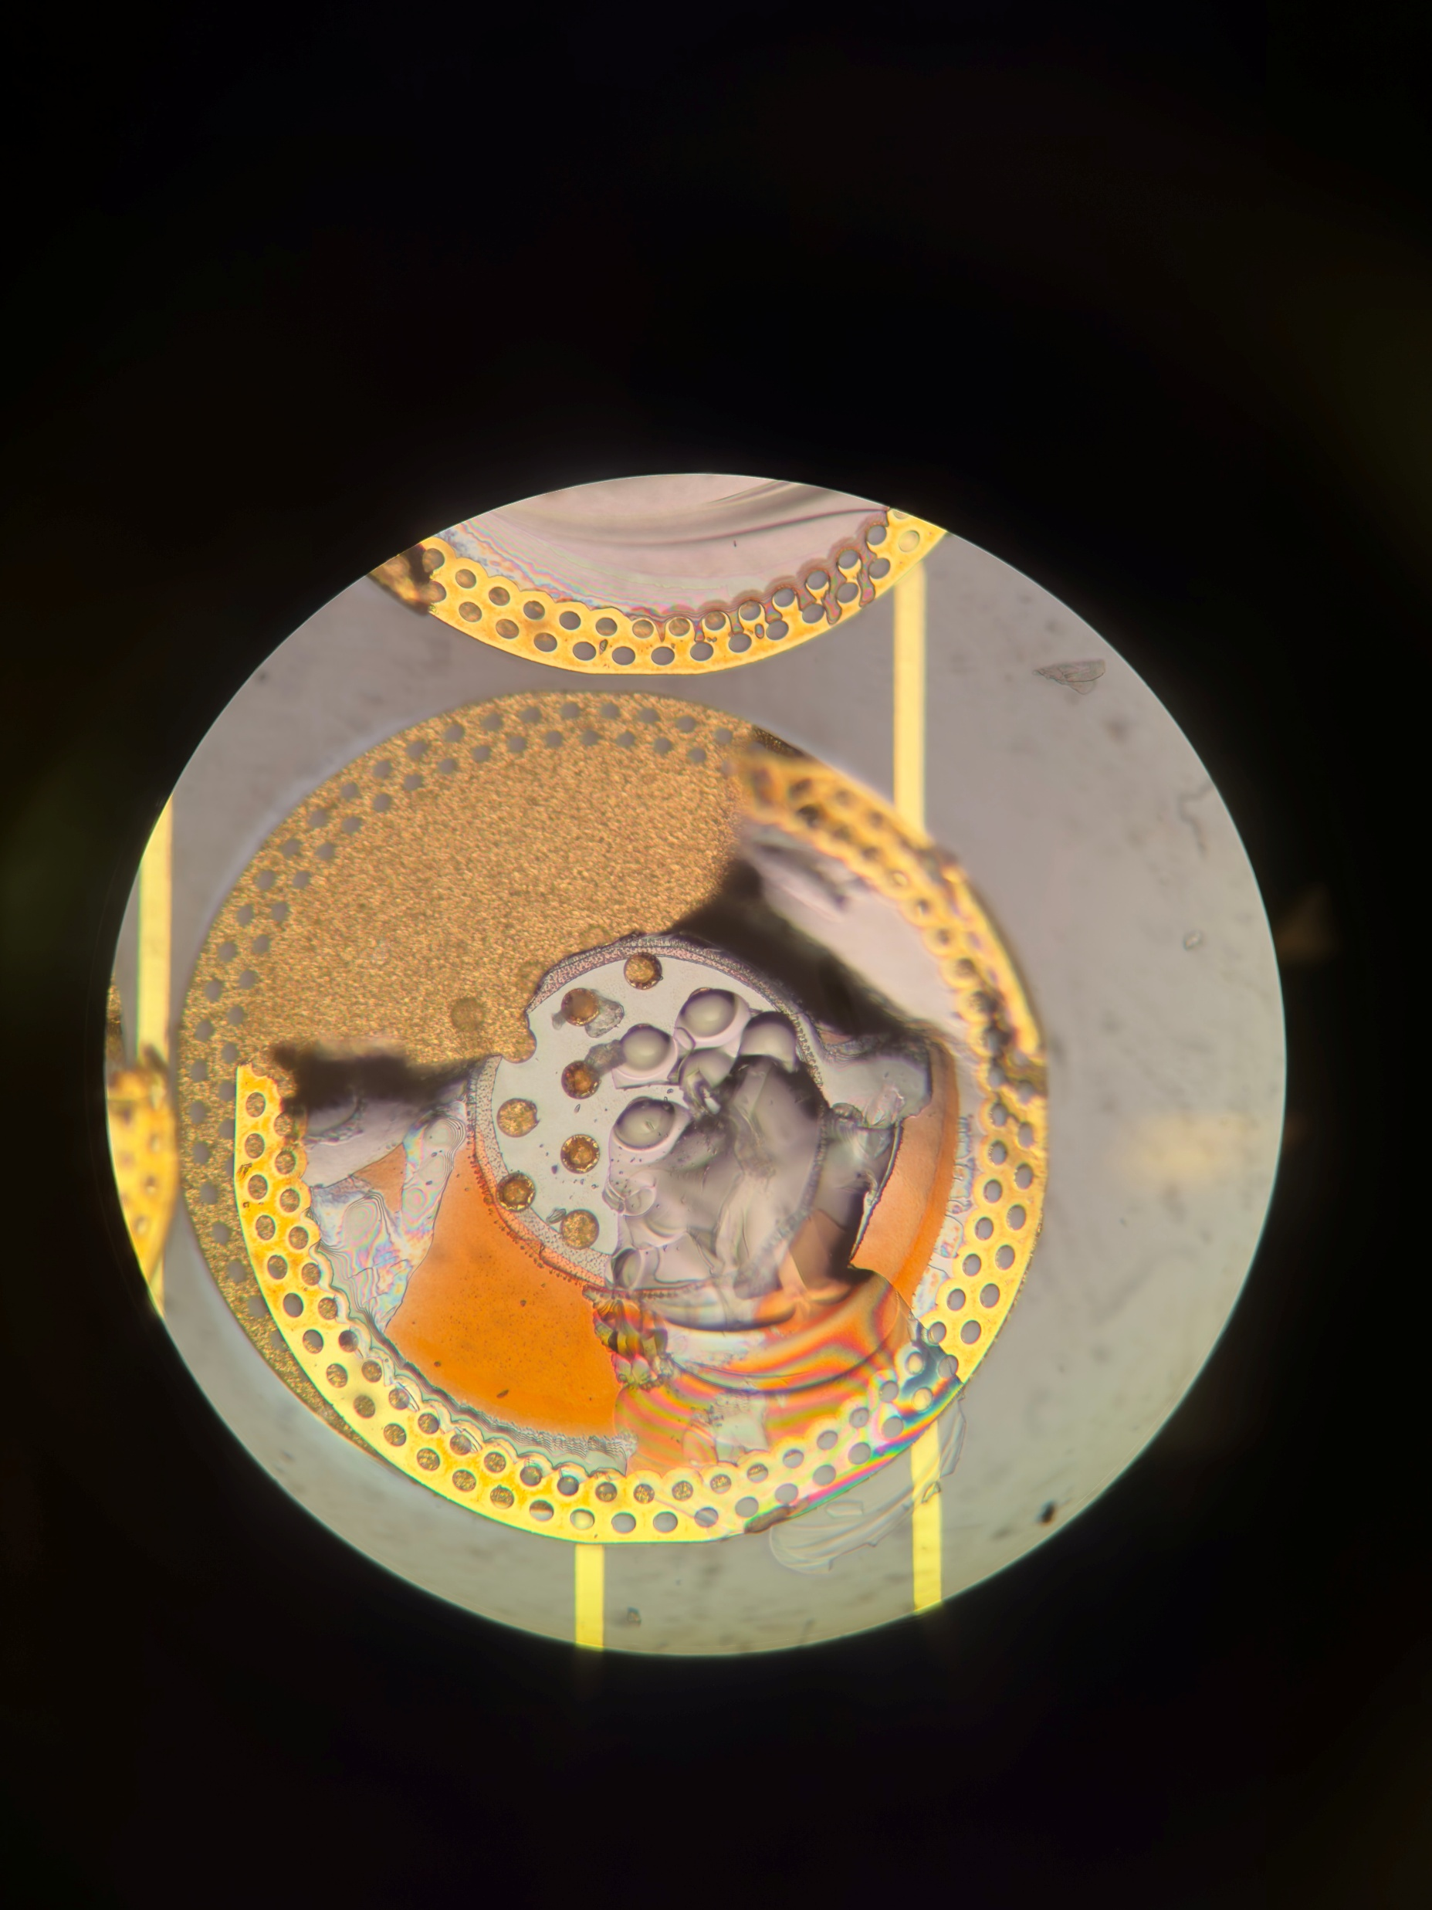
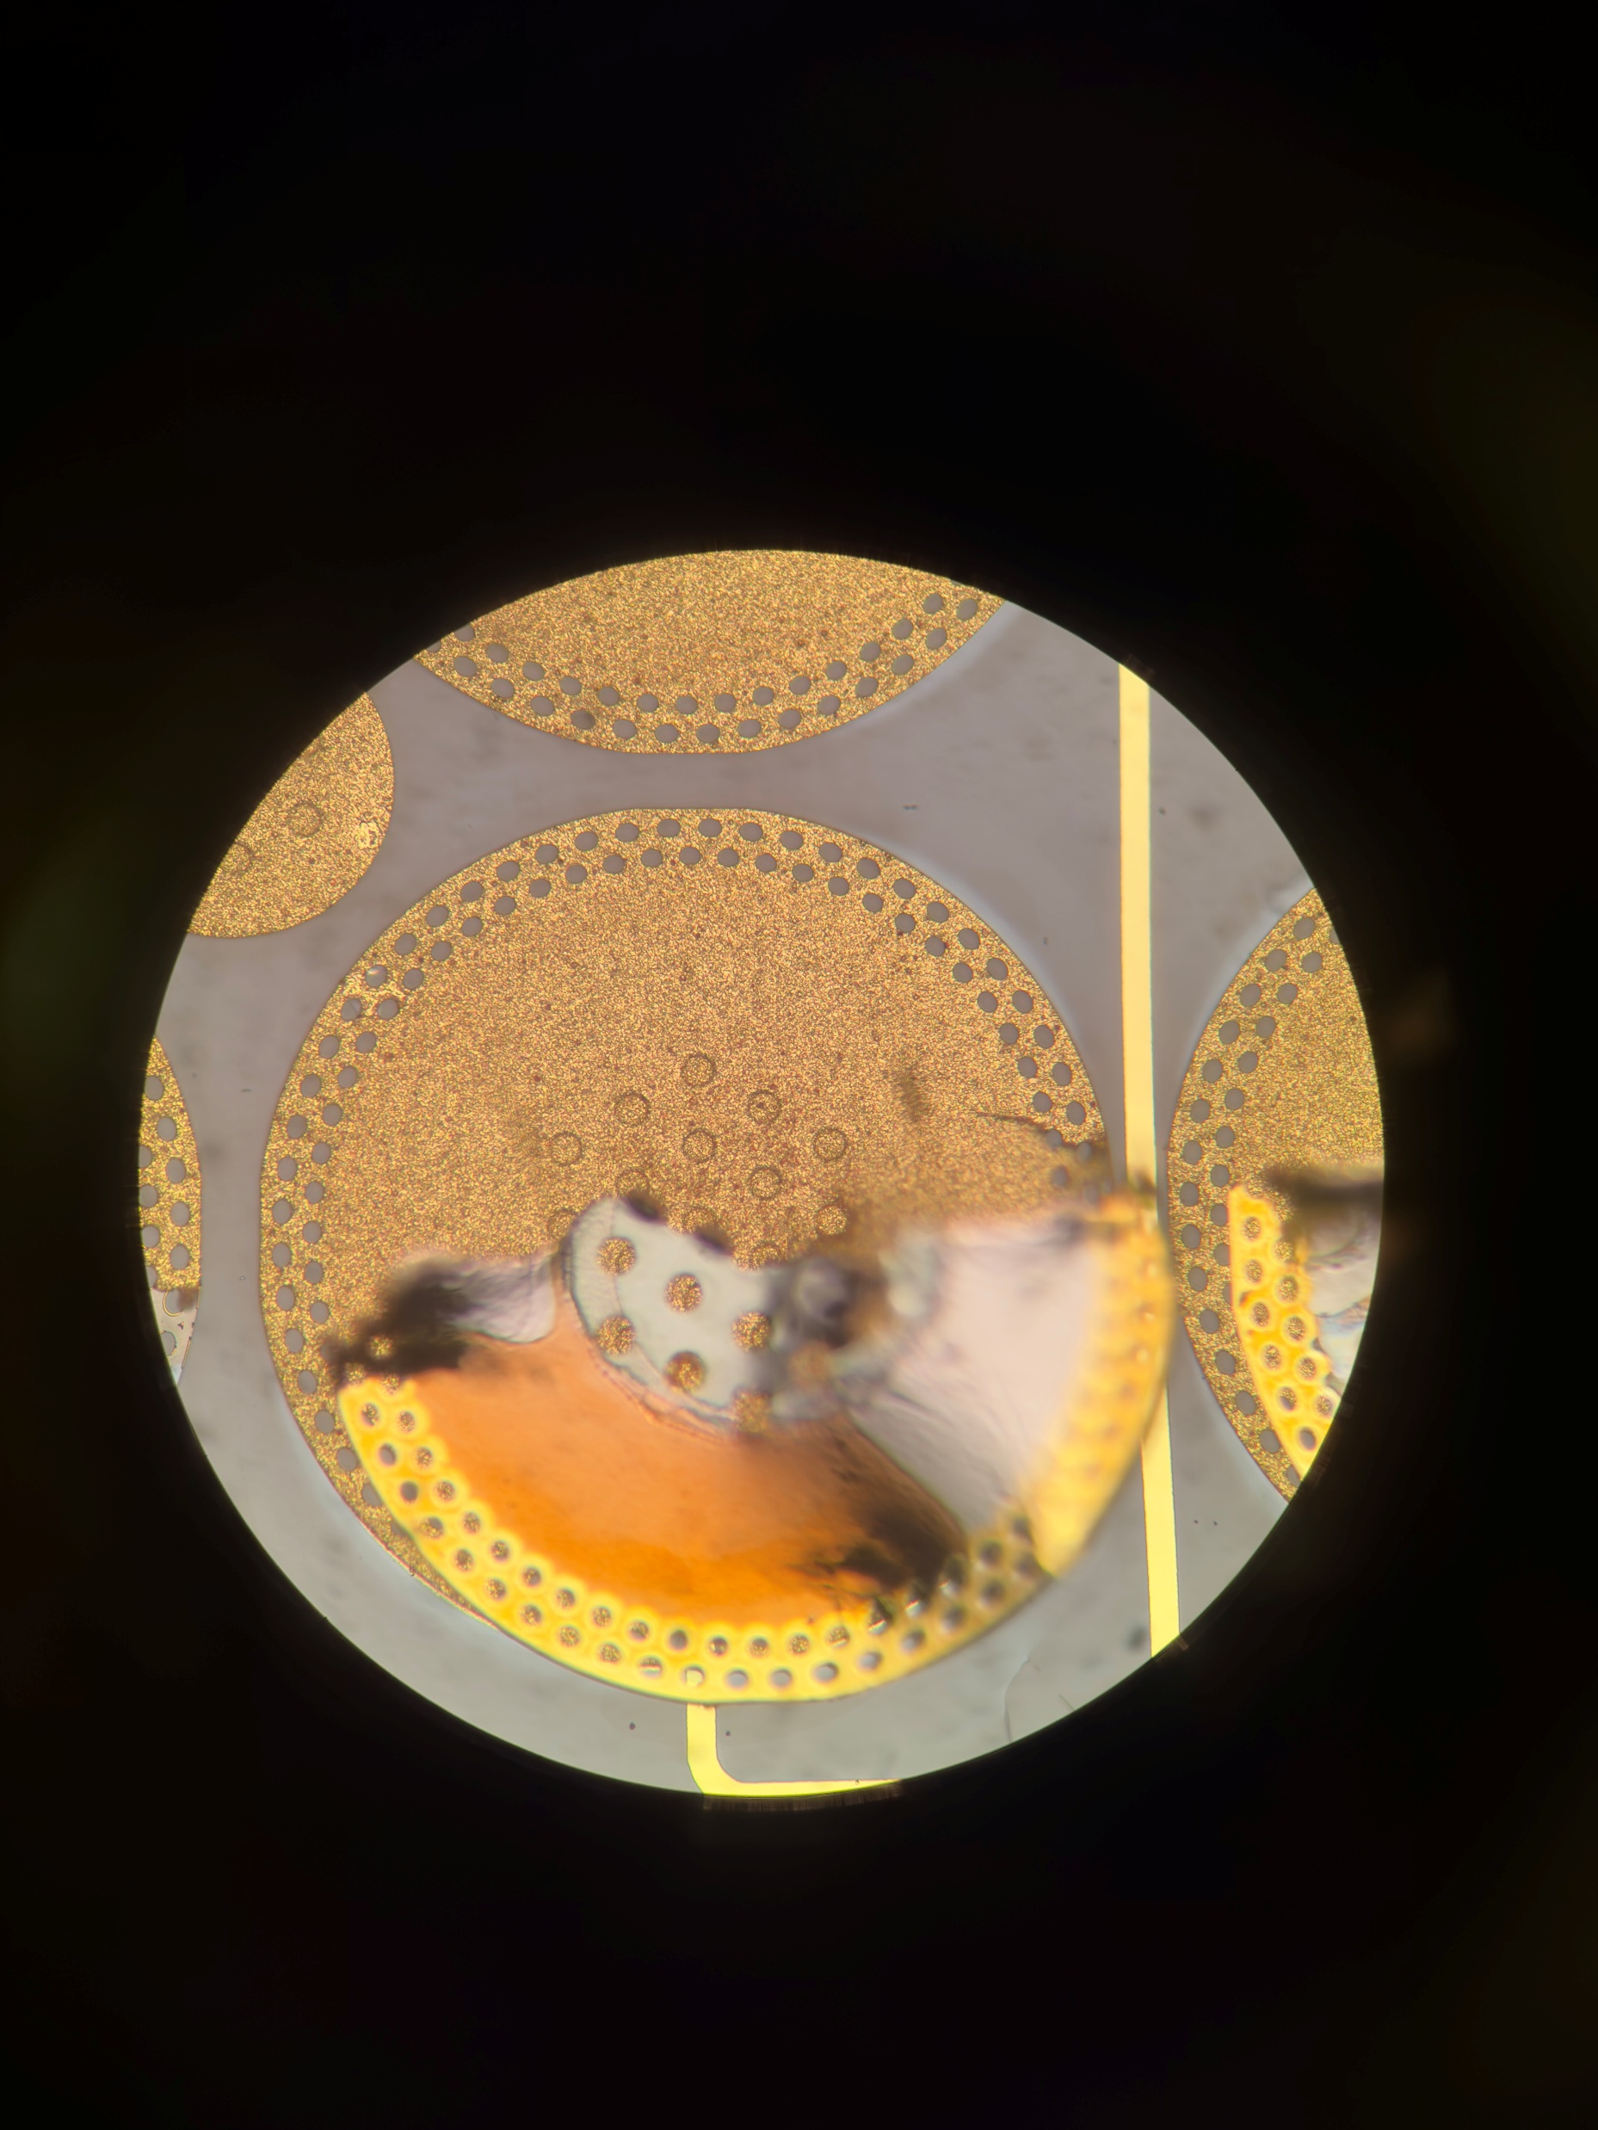
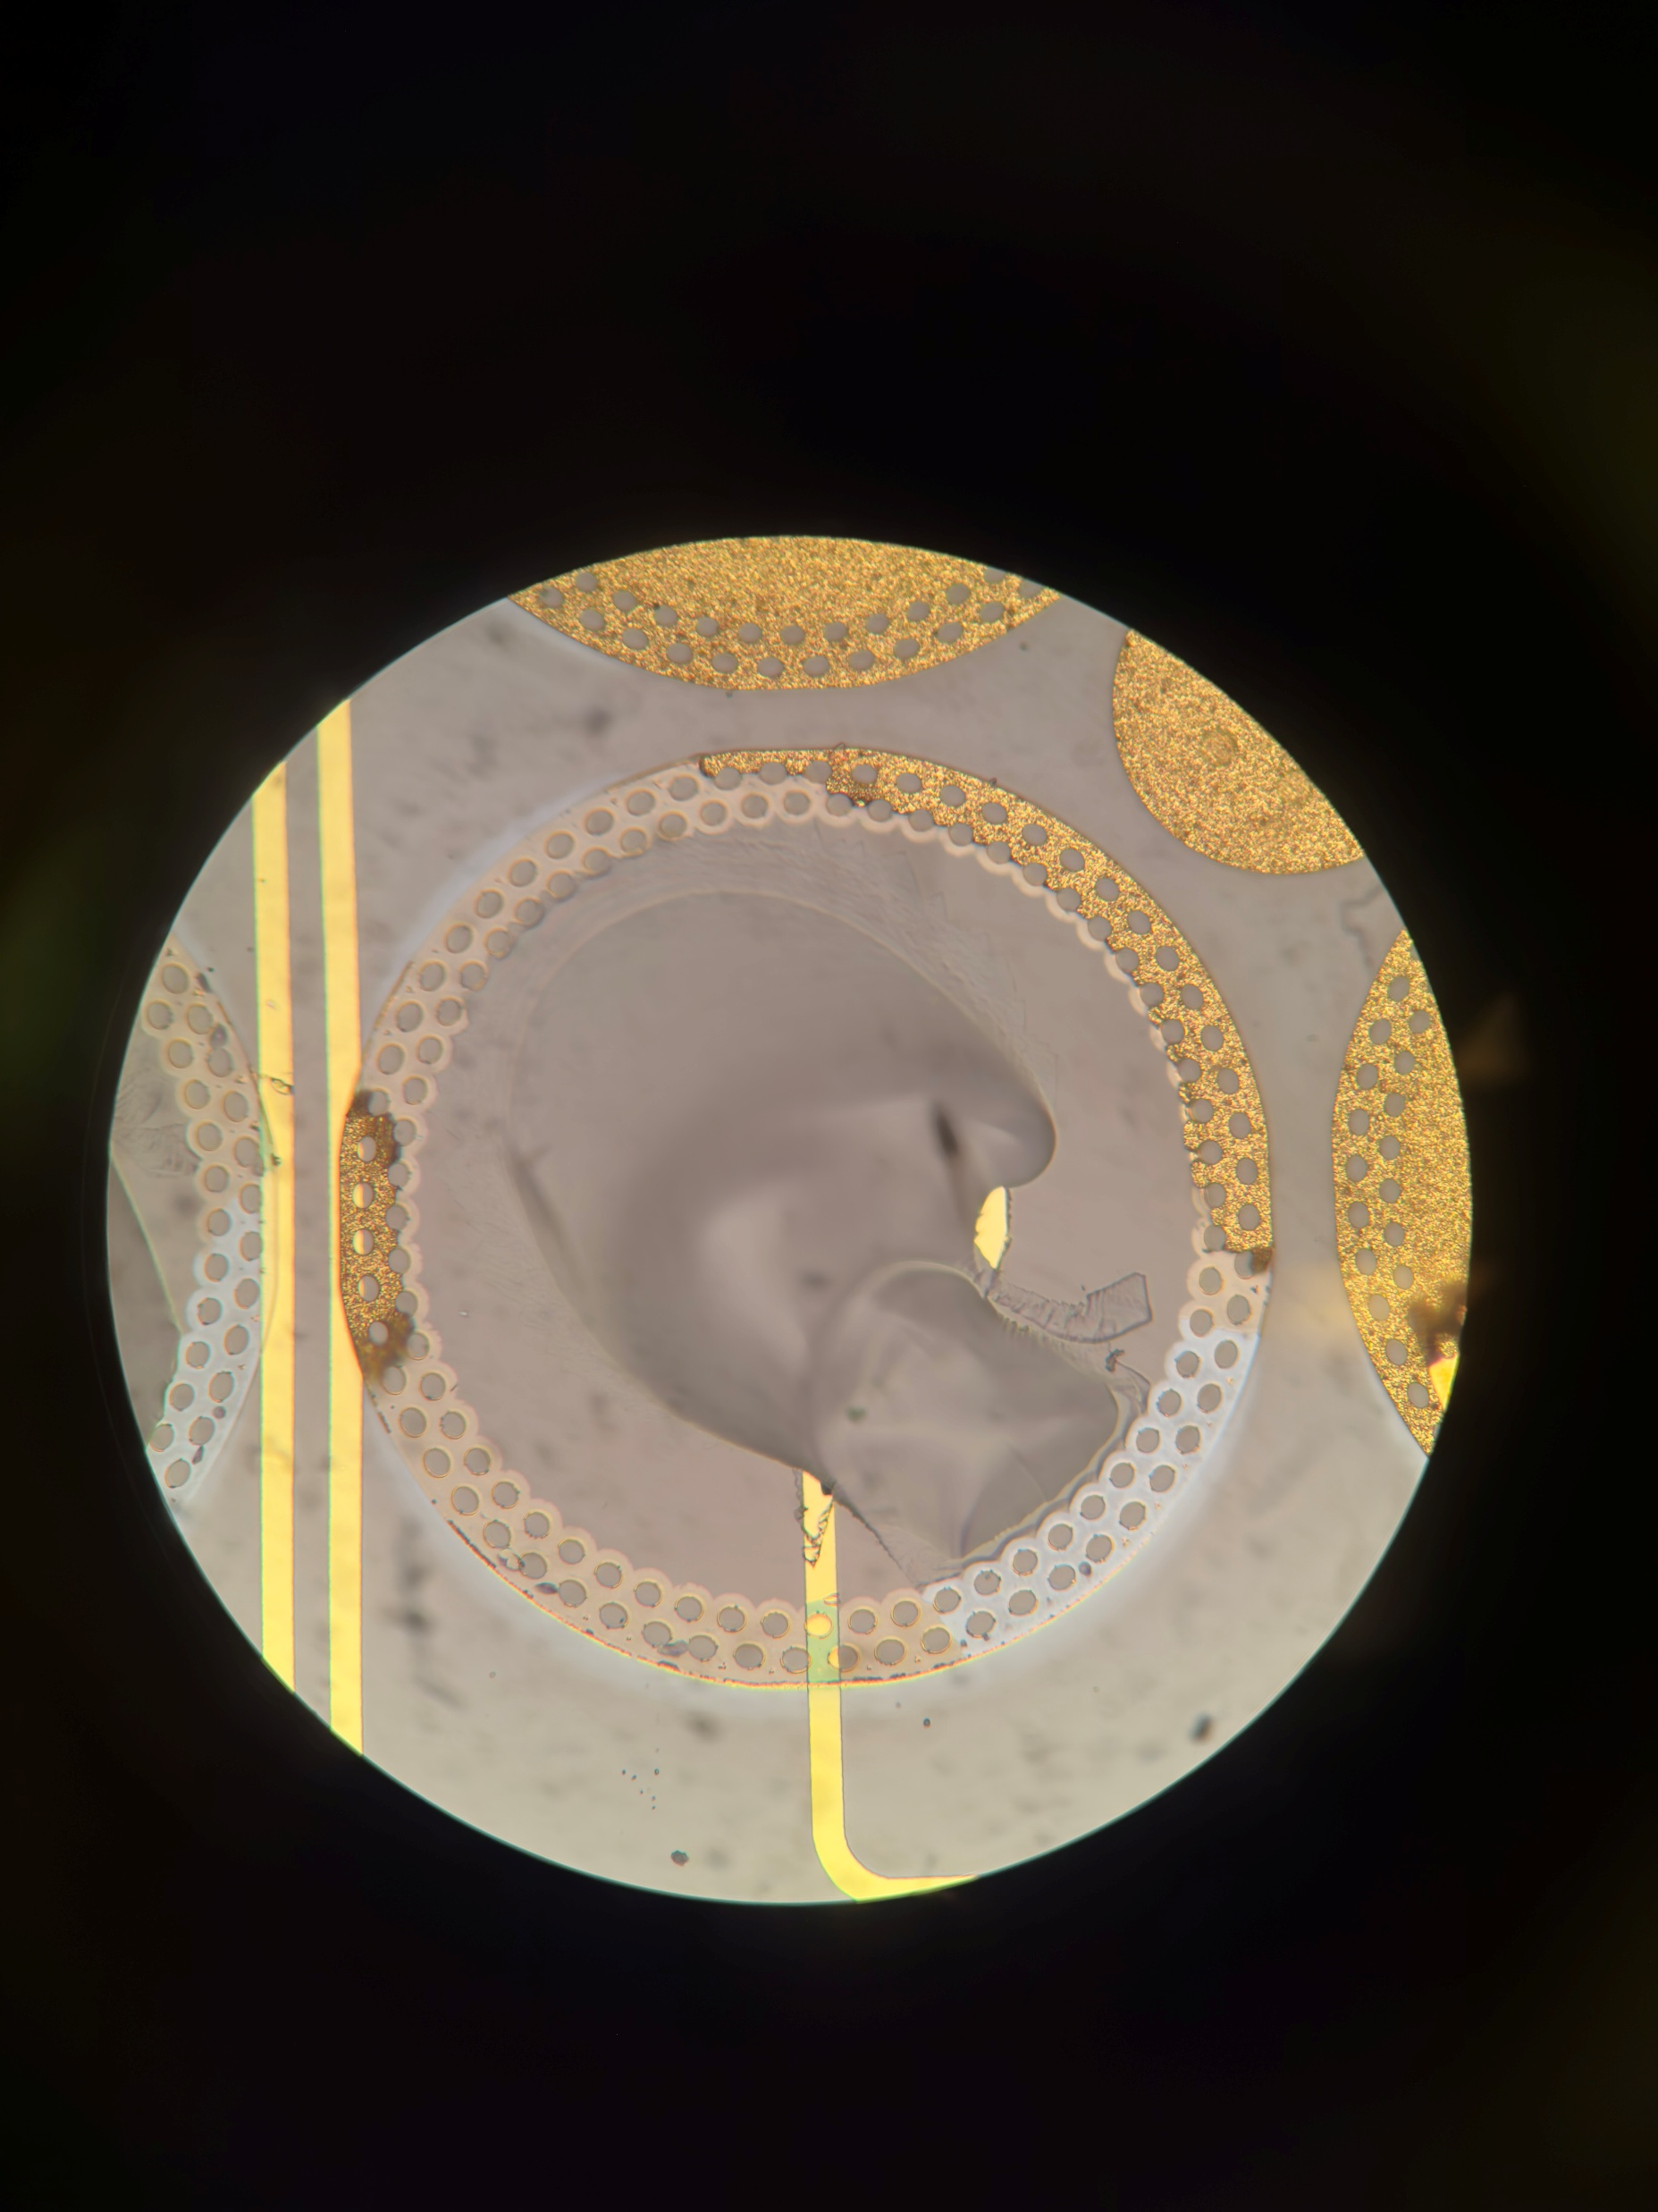
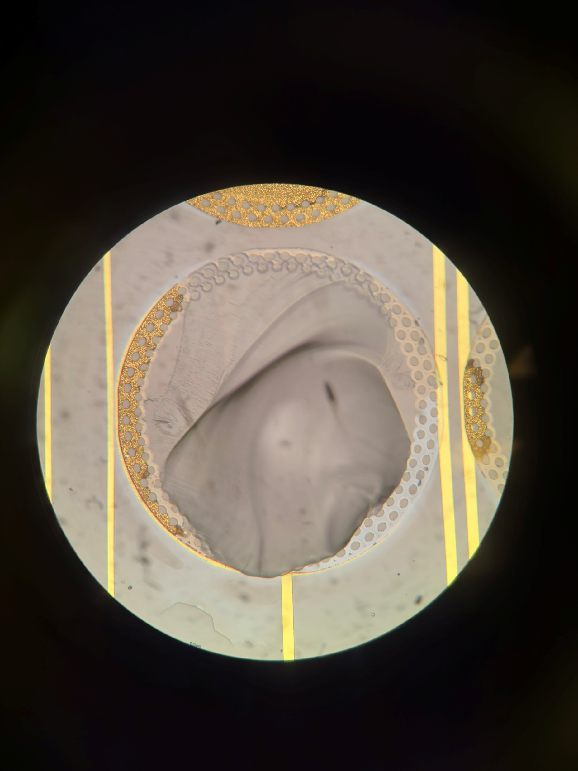
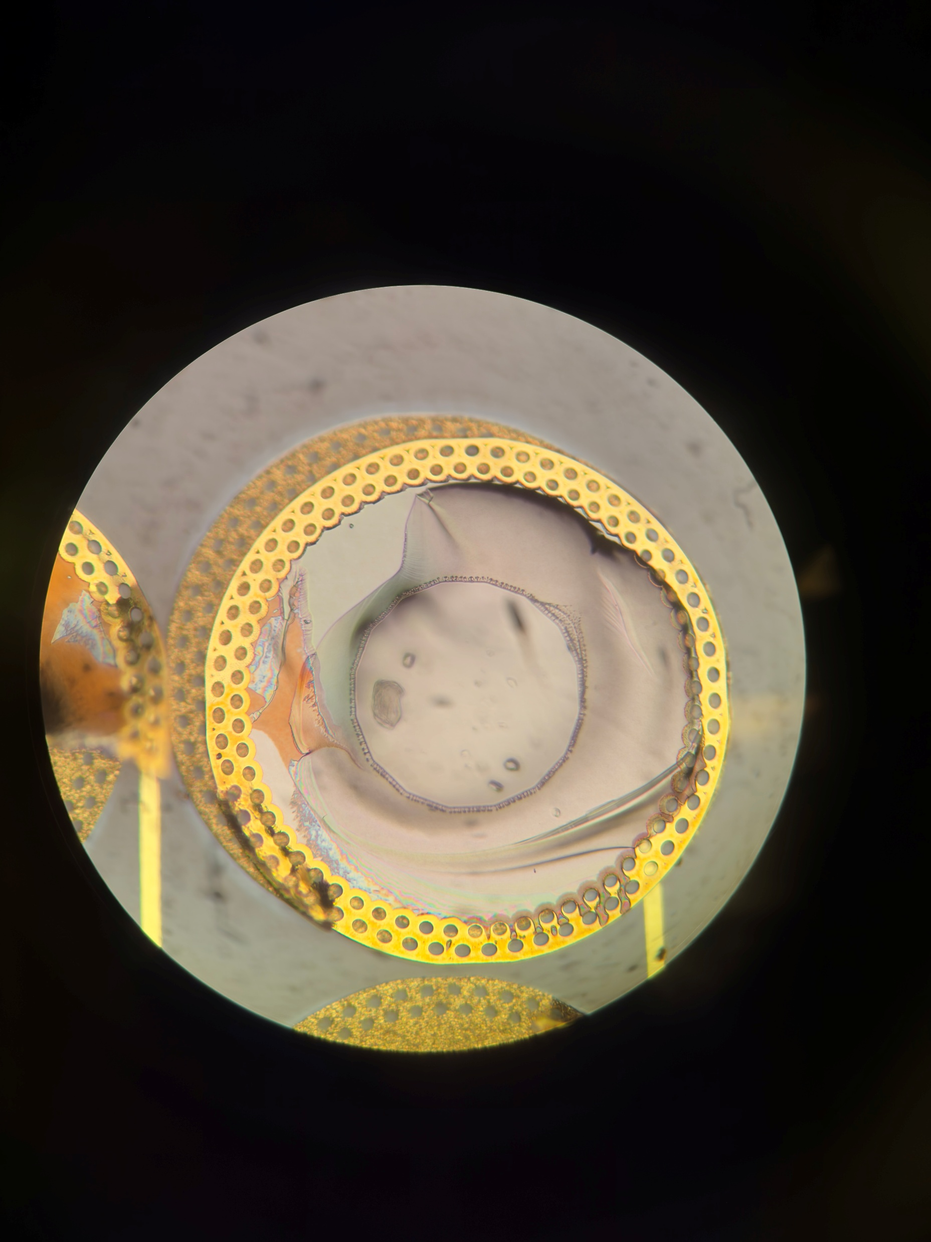
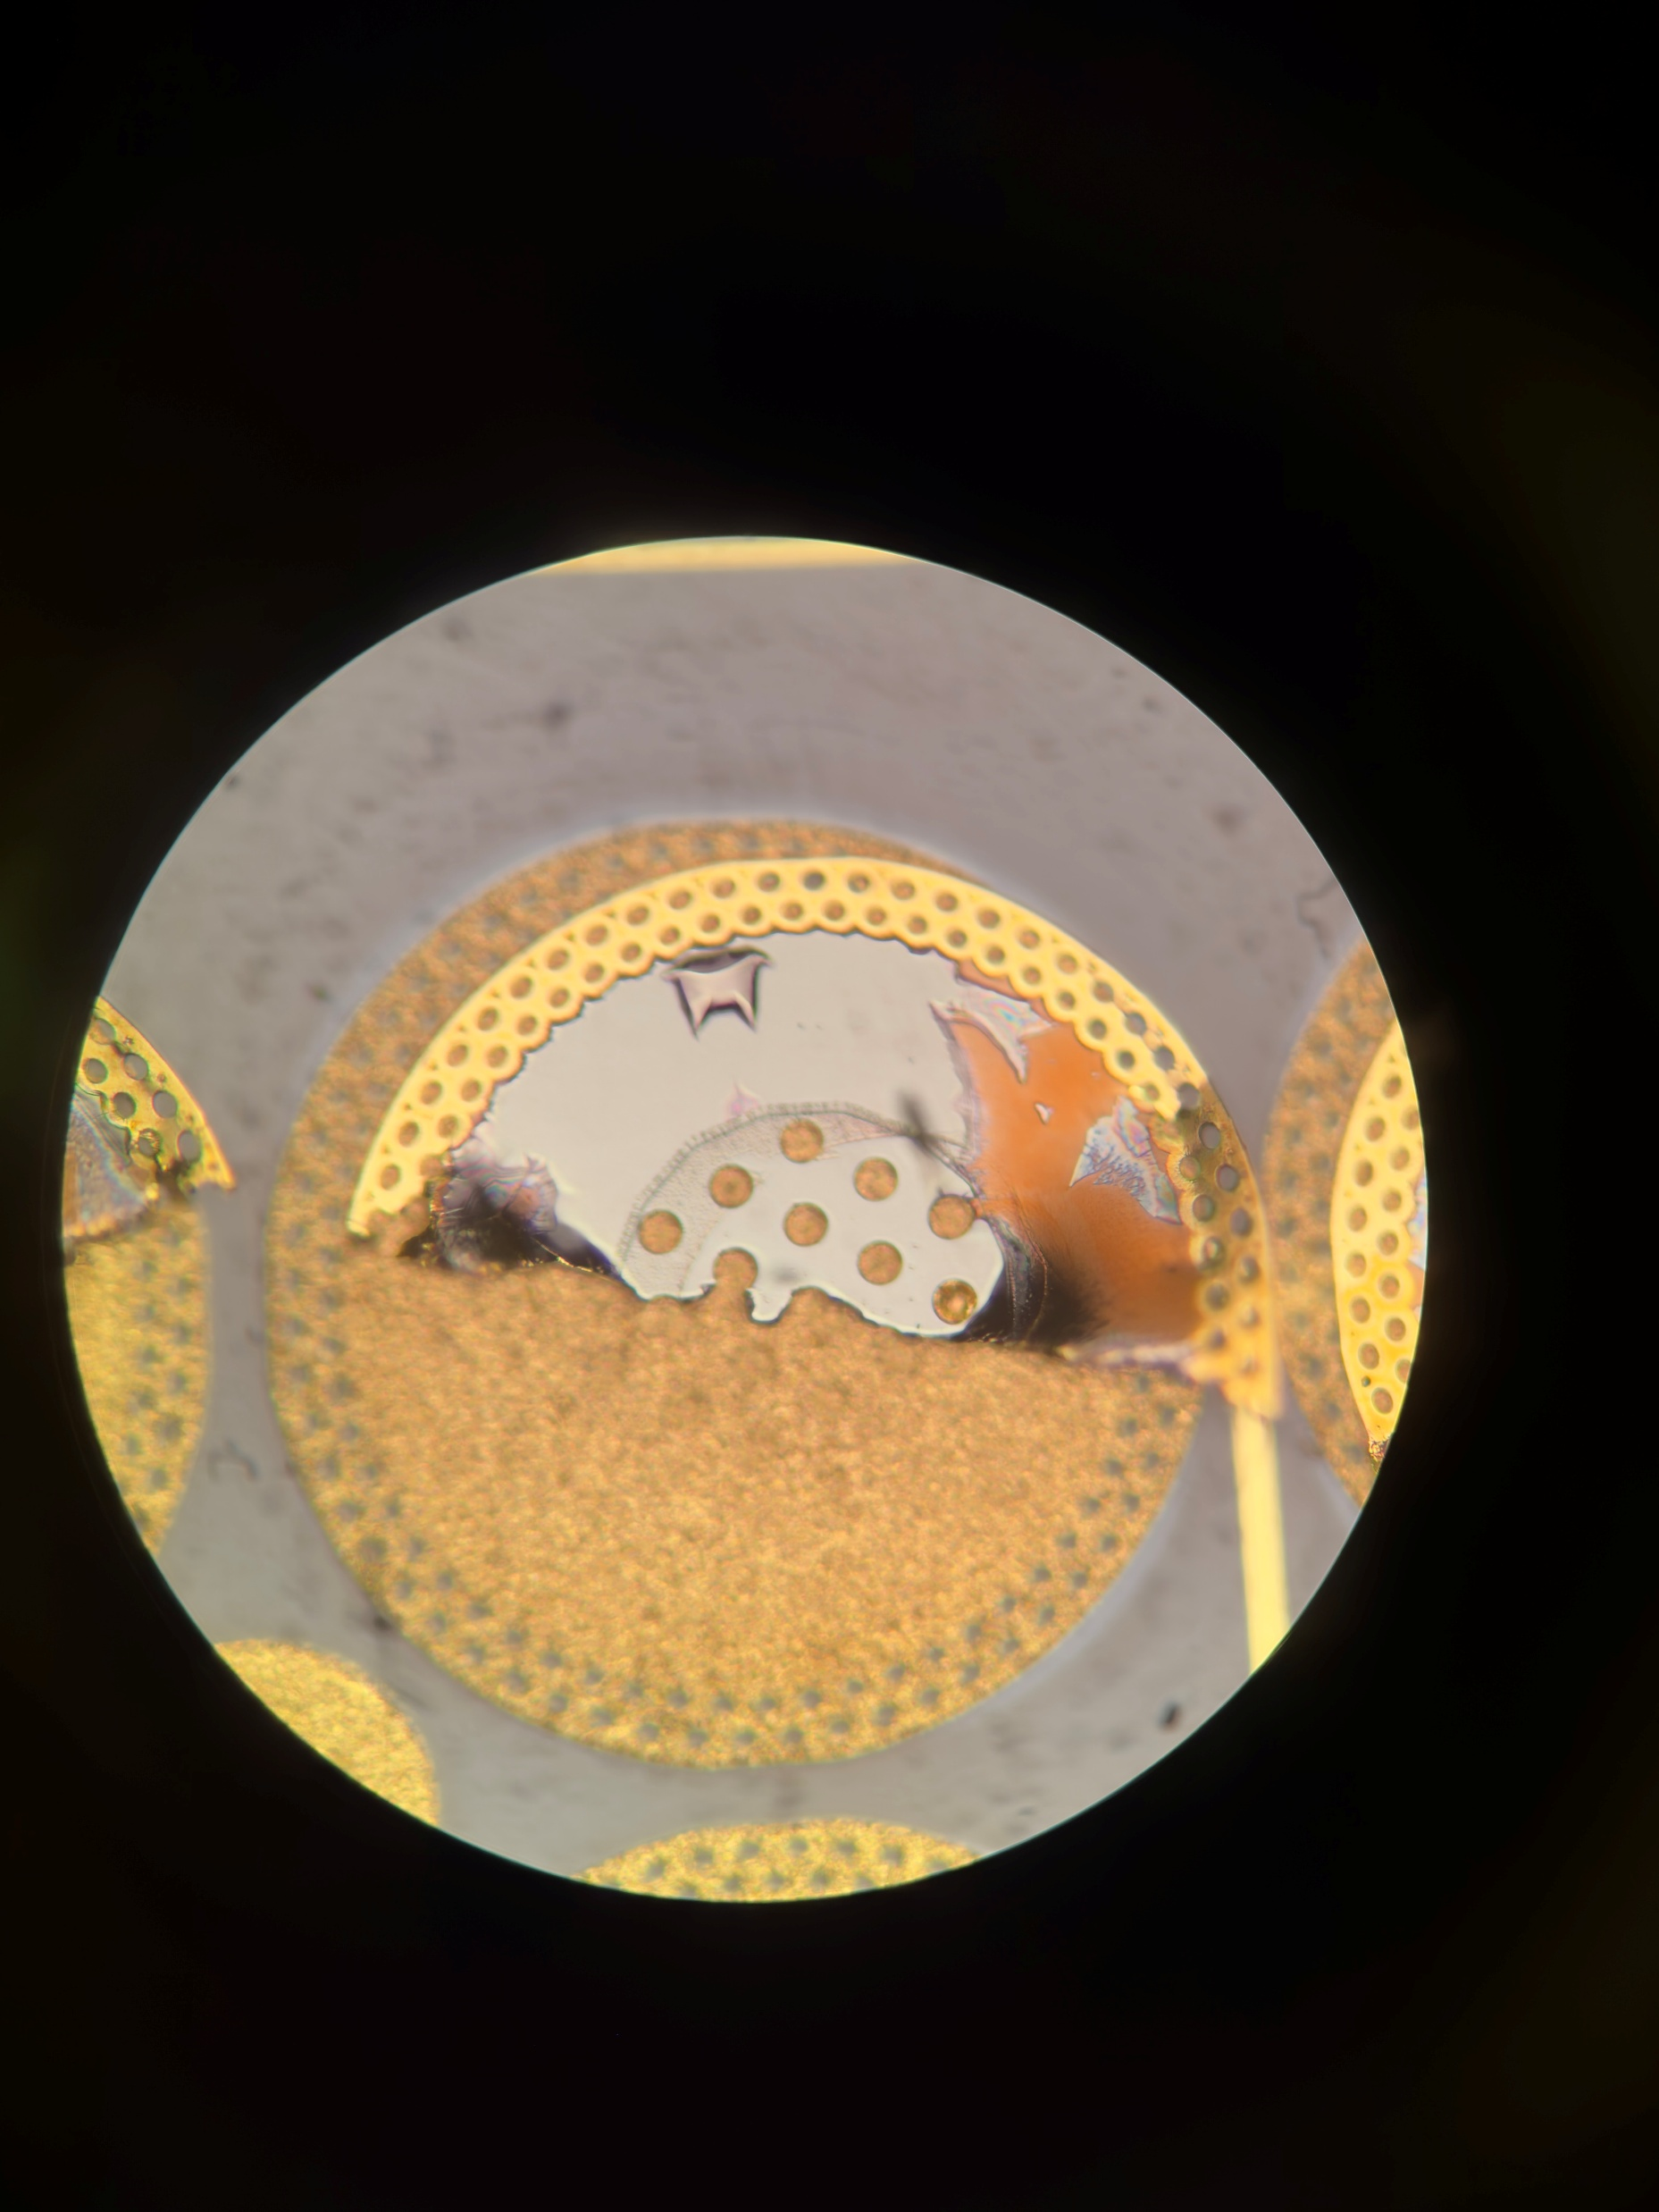
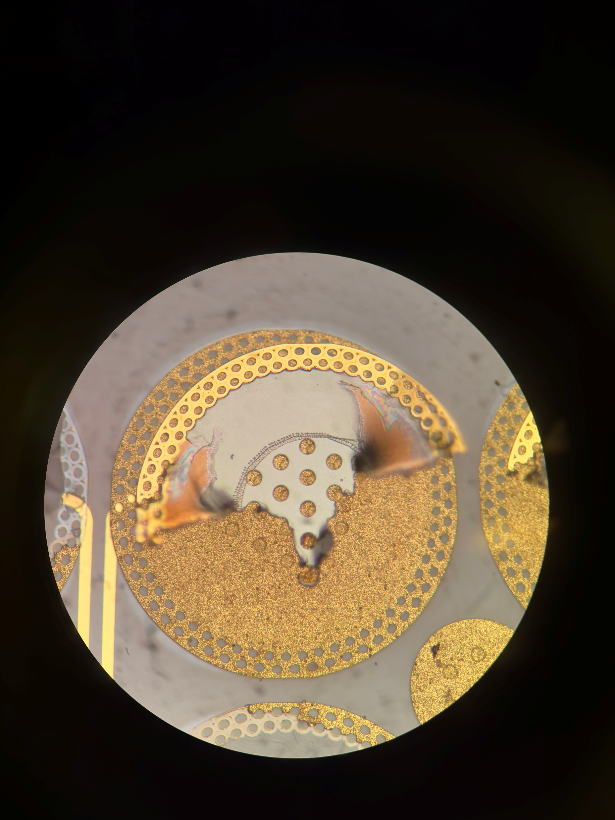
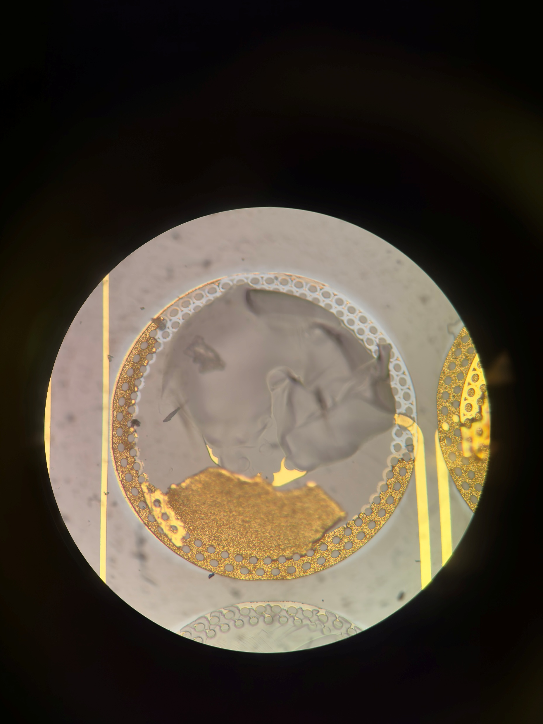
65 Nearside: Types of Failure:
Glass Failure (Pad 3,4,5,8):
Located within pad itself, so formed during bonding due to compression fractures in glass.
Fracture region stays within the pad itself, does not exceed boundary.
Notes:
A72
Need to check between unbonded and compressed strip, whats the change in gold height.

Slide 8
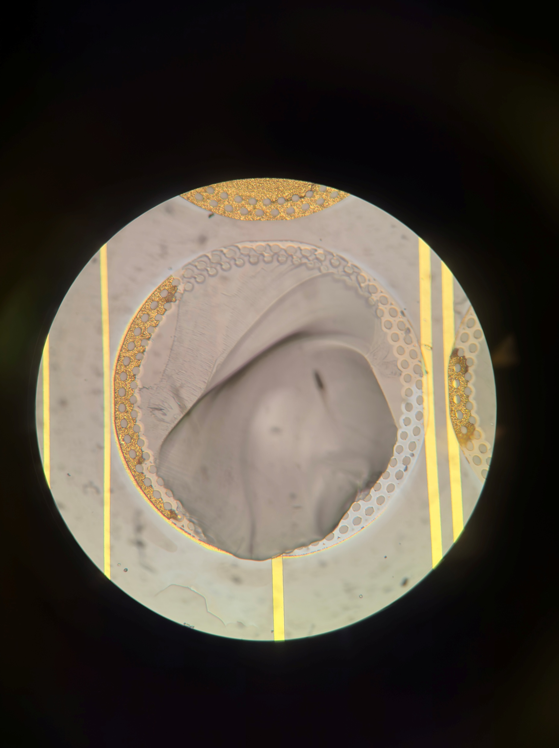
65 Nearside: Types of Failure:
Glass-Titanium Failure:
Silver portion of pads visible,
Notes:
A72
Need to check between unbonded and compressed strip, whats the change in gold height.

Slide 9

65 Nearside:Pad 1
Presence of Glass failure, titanium-glass failure, titanium-gold failure(?)
Glass failure:
Failure of glass beneath pad, leading to PECVD on the edge (where iridescence is)
Conchoidal fractures seen right below vias
Spreads from center outwards
Notes:
A72
Need to check between unbonded and compressed strip, whats the change in gold height.

Slide 10
65 Nearside:Pad 1
Presence of Glass failure, titanium-glass failure, titanium-gold failure(?)
Titanium-Glass failure
Grey area seen
Pad has partially lifted off
Notes:
A72
Need to check between unbonded and compressed strip, whats the change in gold height.

Slide 11
65 Nearside:Pad 1
Presence of Glass failure, titanium-glass failure, titanium-gold failure(?)
Titanium-Gold failure(?)
Brown areas
Notes:
A72
Need to check between unbonded and compressed strip, whats the change in gold height.

Slide 12
65 Nearside:Pad 2
Titanium-Gold failure(?)
Brown areas?
Notably for the other pad, the vias are missing – means they are stuck on the corresponding pad.
Other than Pad 1, this is normally what happens.
(6um difference in height, which is the height of a pad)
Failure occurs above PECVD layer, in Gold layer as vias are ‘pulled’ out.
Notes:
A72
Need to check between unbonded and compressed strip, whats the change in gold height.

Slide 13
65 Nearside
Pad 3,4:
Glass failure, drop in height to -13um.
Shape similar to that of a conchoidal fracture.
Glass fracture stay within the region of the pad, this is probably due to the pre fracturing of the pad causing a boundary which the stress cannot cross.
Notes:
A72
Need to check between unbonded and compressed strip, whats the change in gold height.

Slide 14
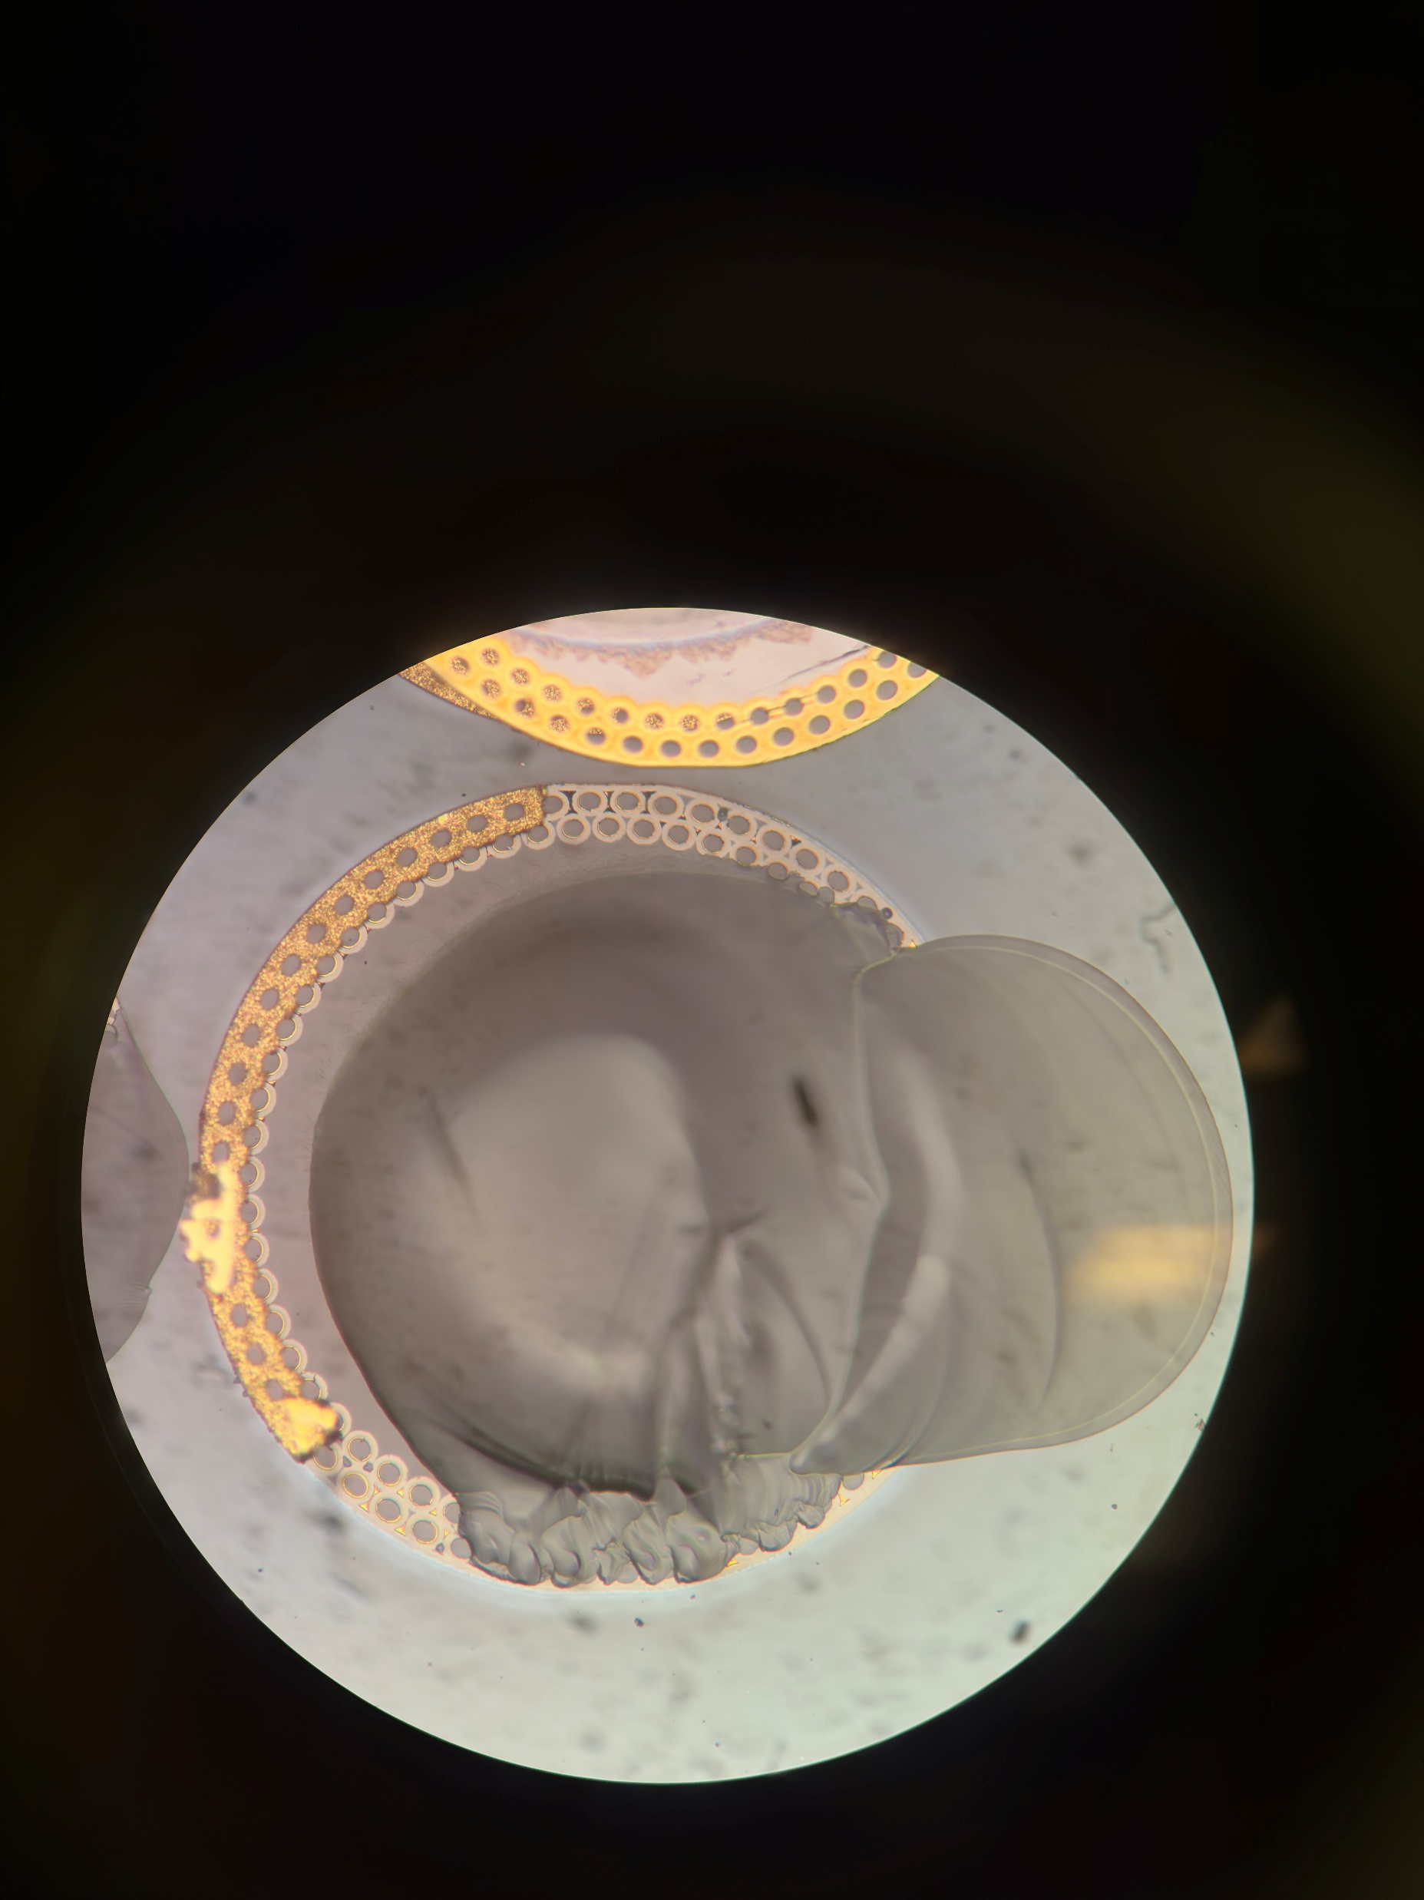
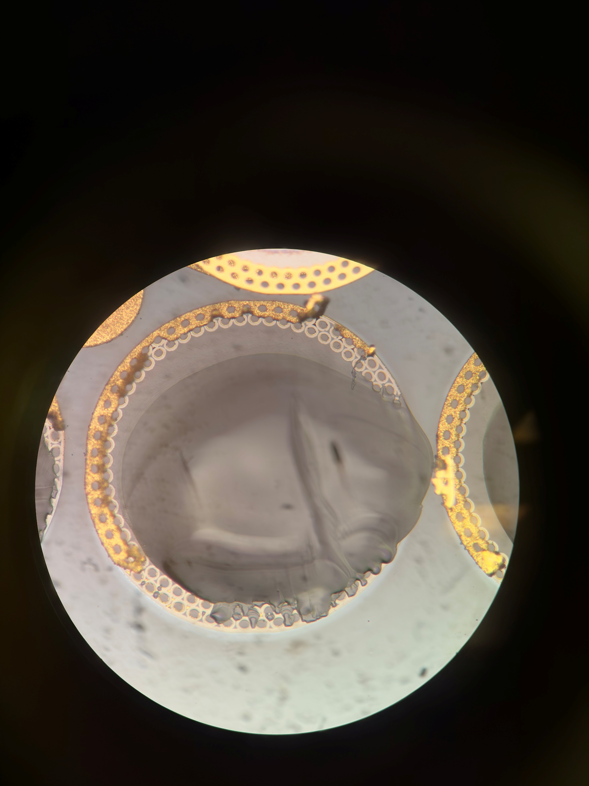
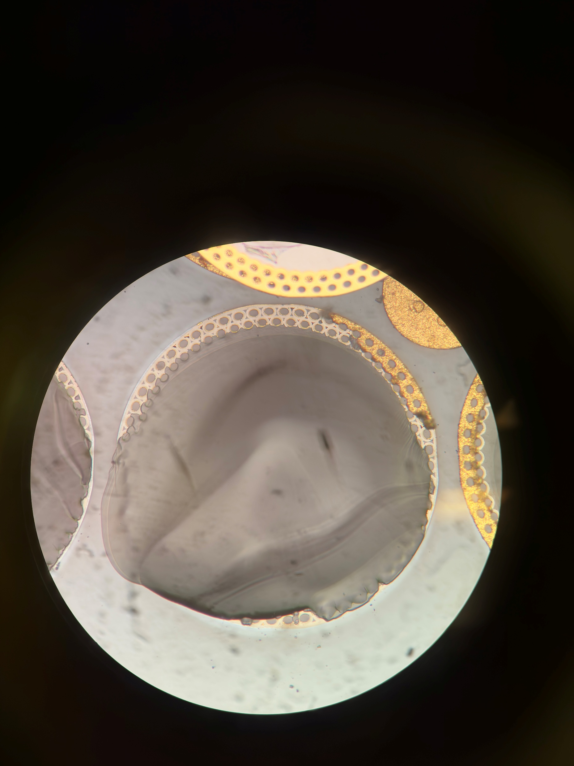
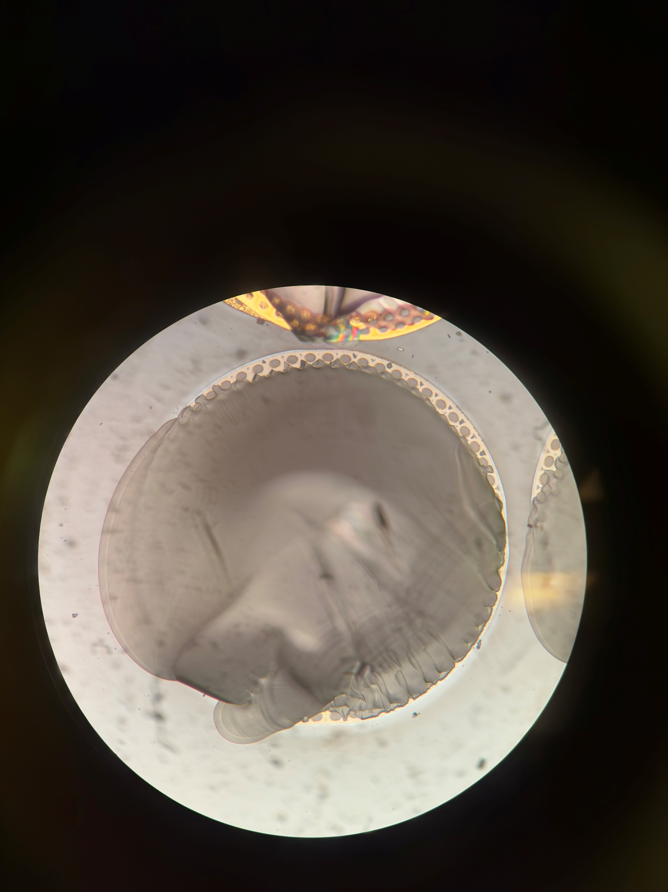
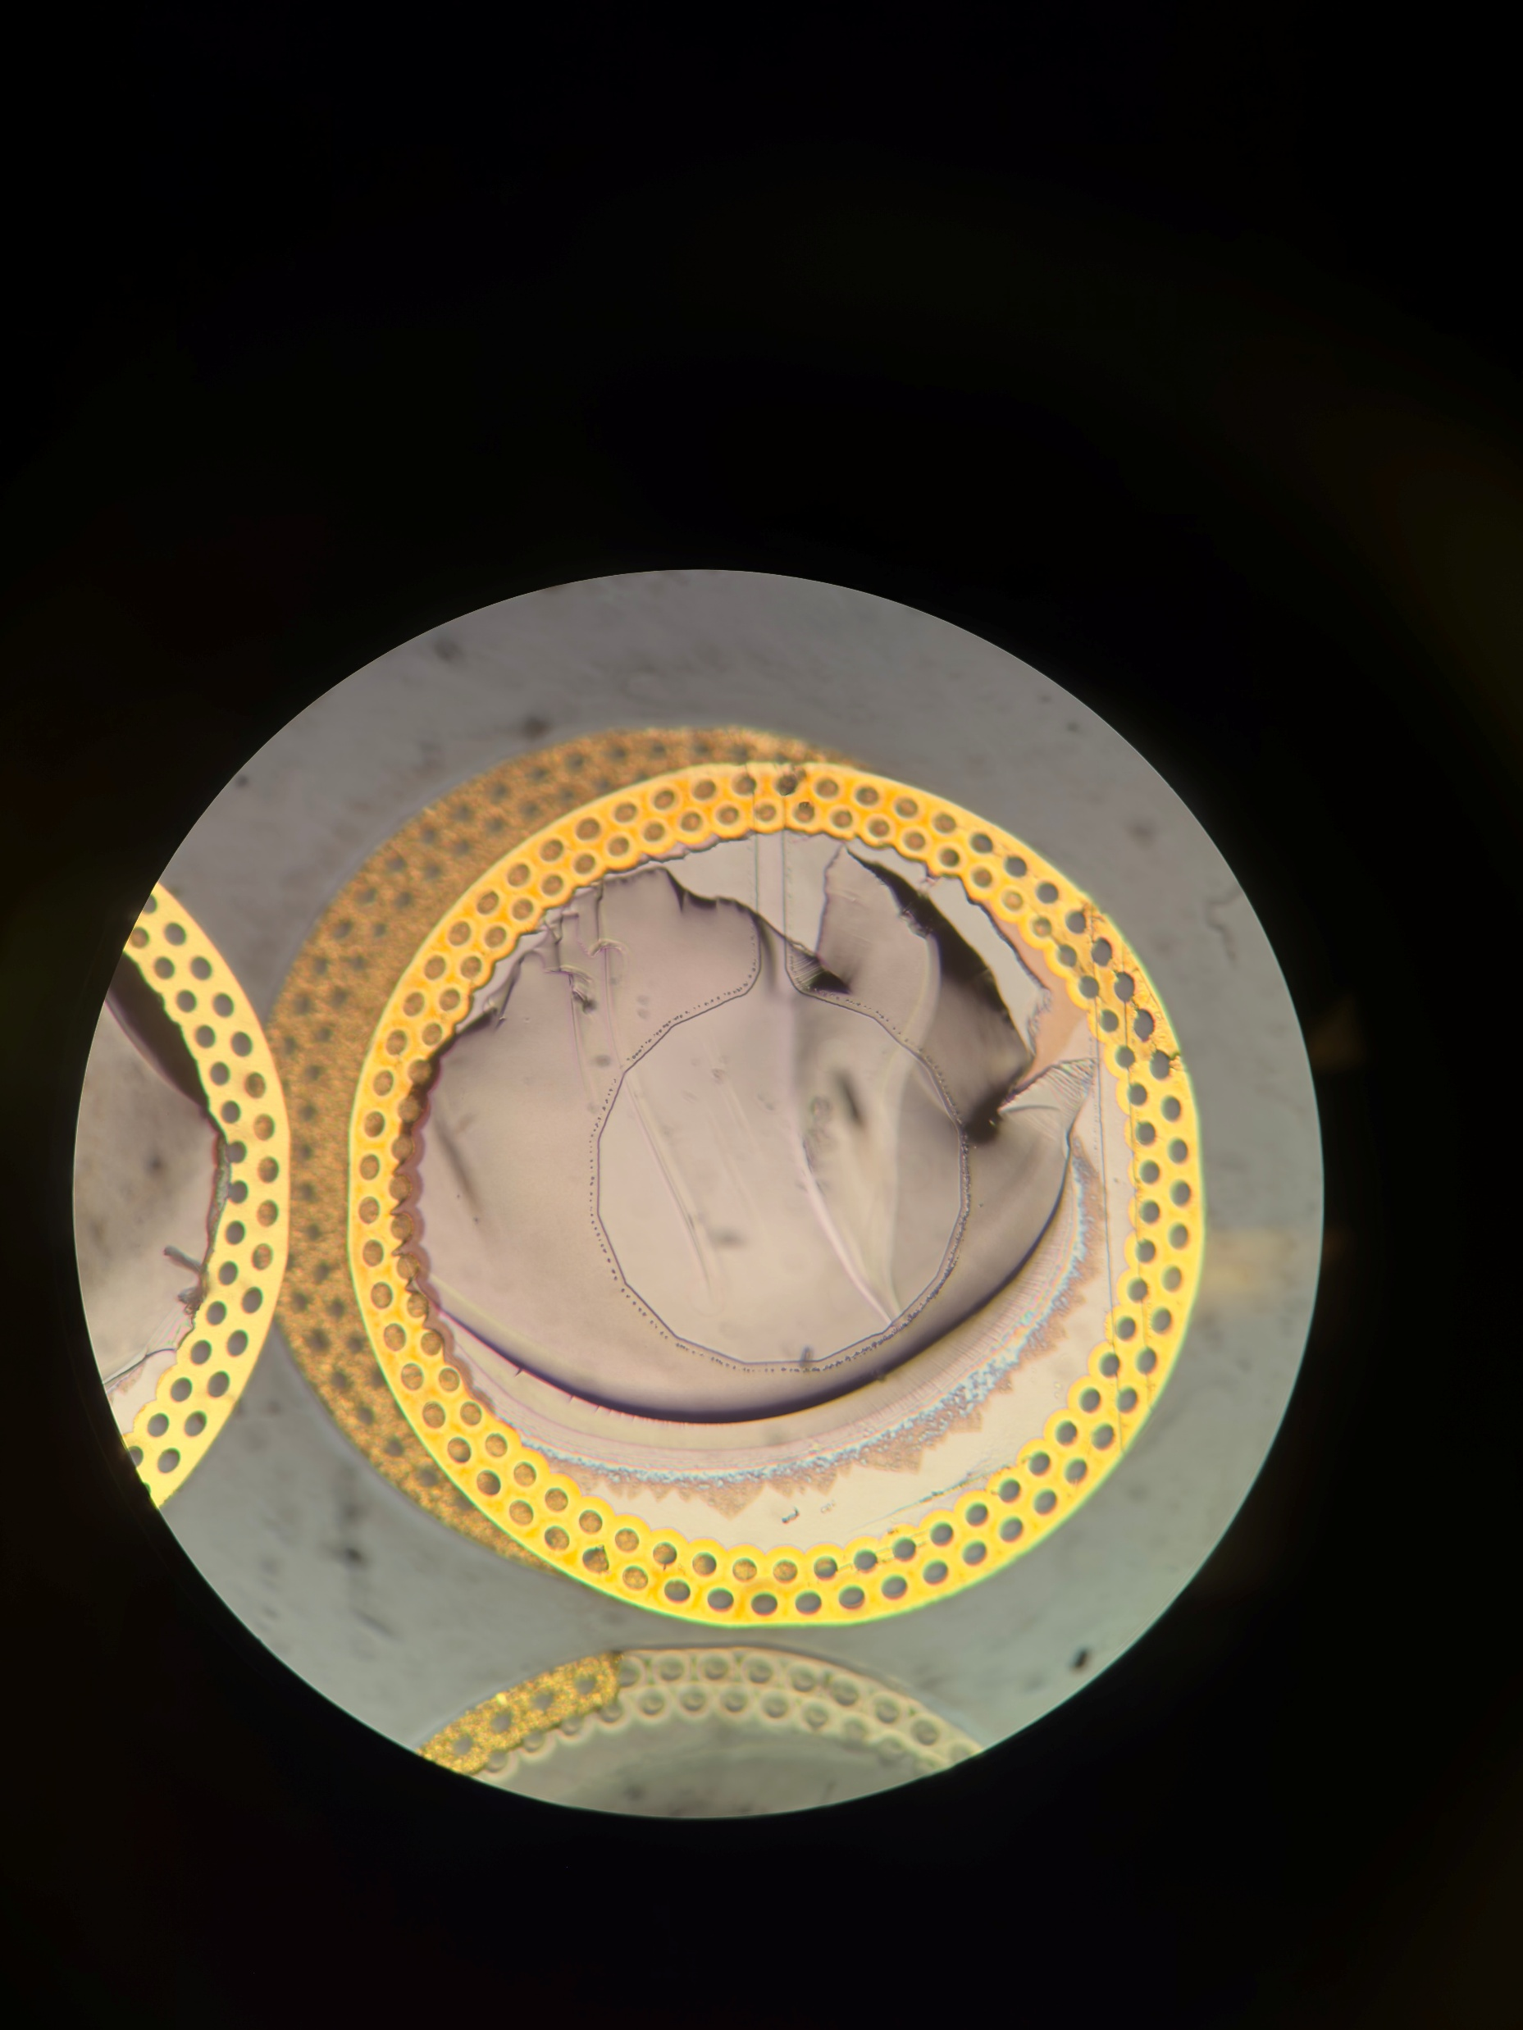
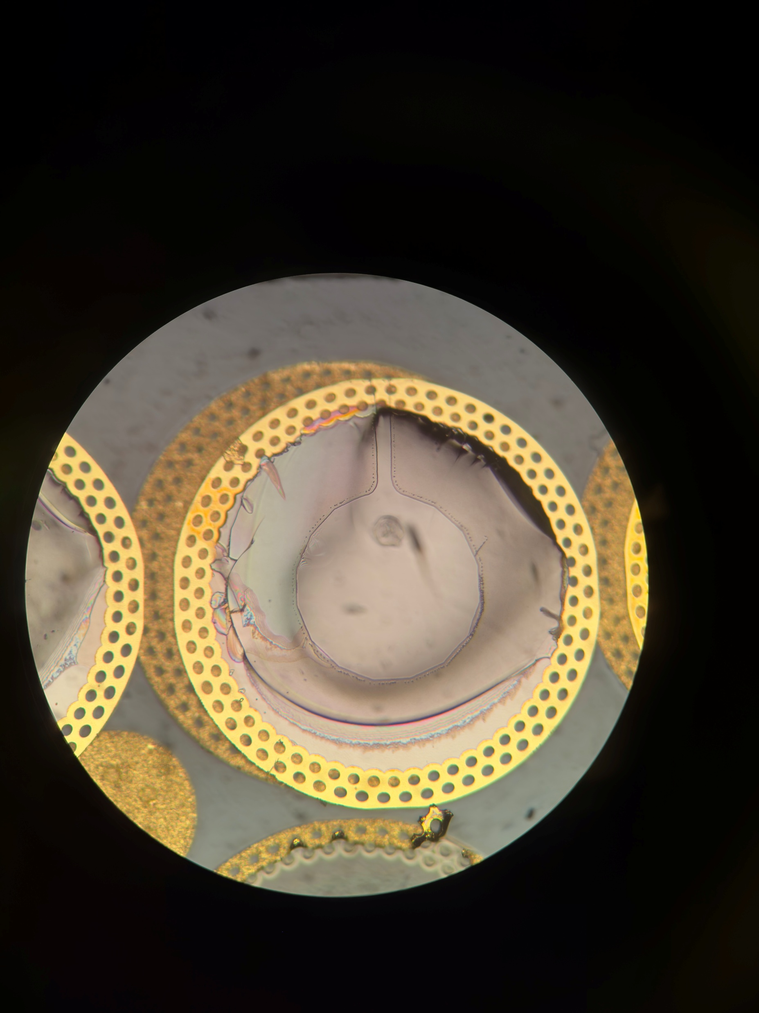
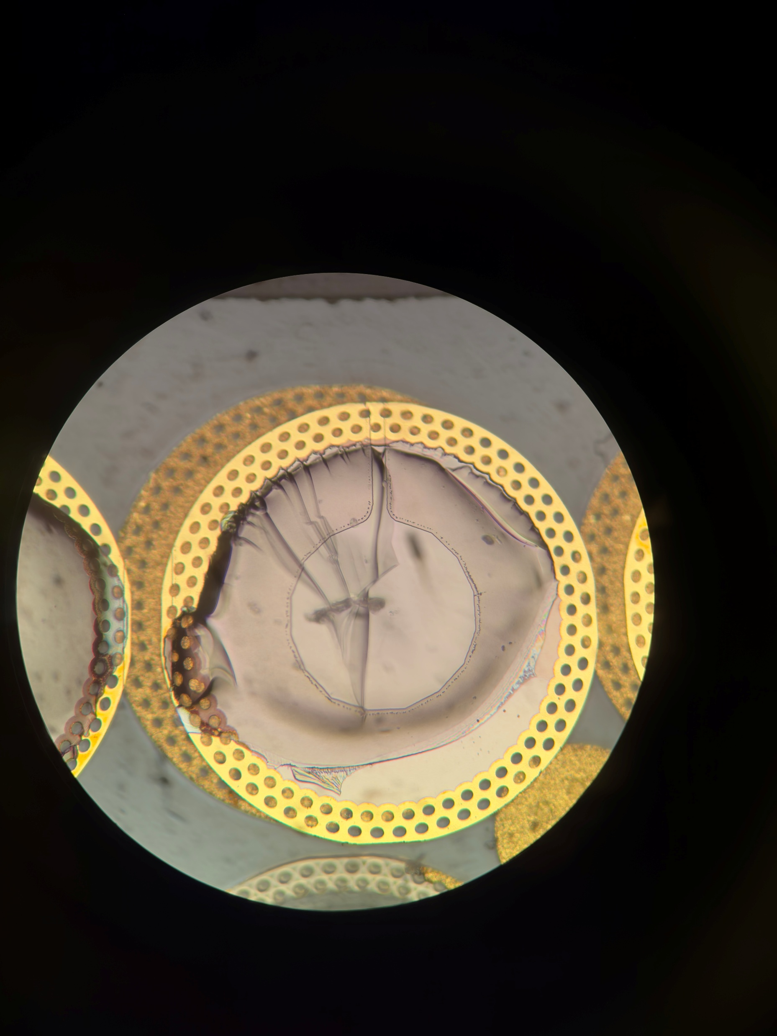
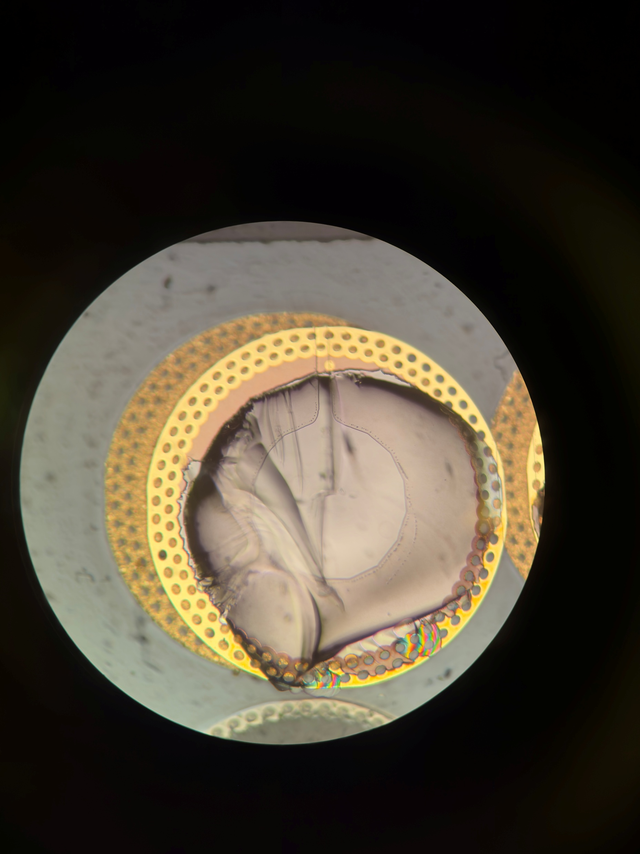
65 Farside
Mainly glass failure seen, Pad 1 had a conchoidal fracture leaving the pad
Probably a tensile glass failure
Notes:
A72
Need to check between unbonded and compressed strip, whats the change in gold height.

Slide 15
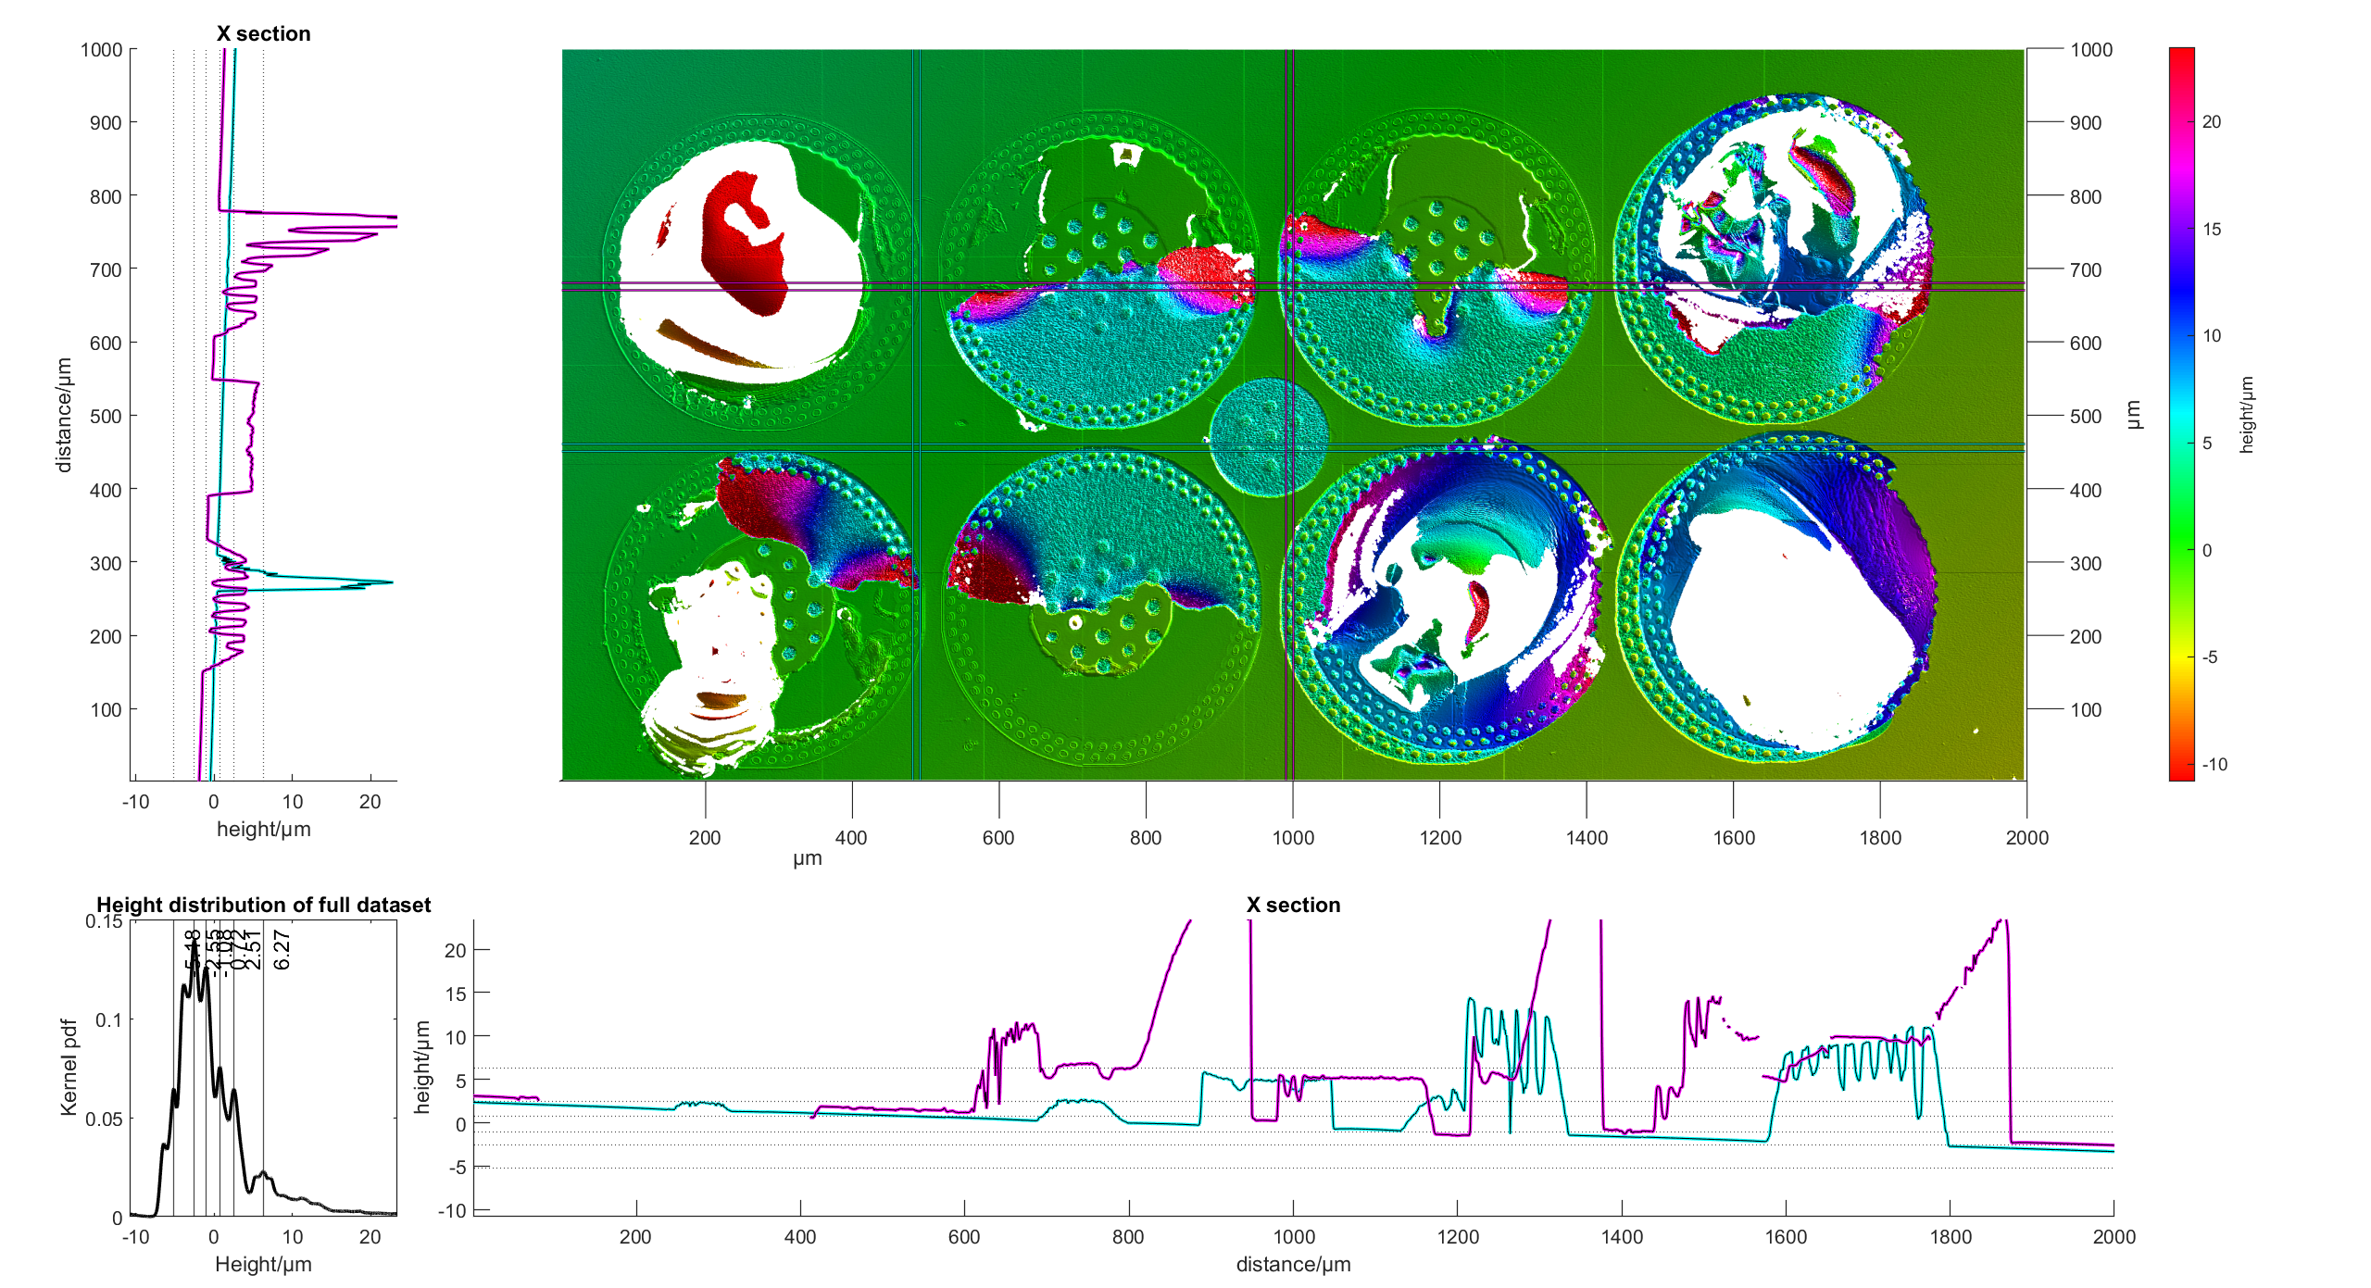
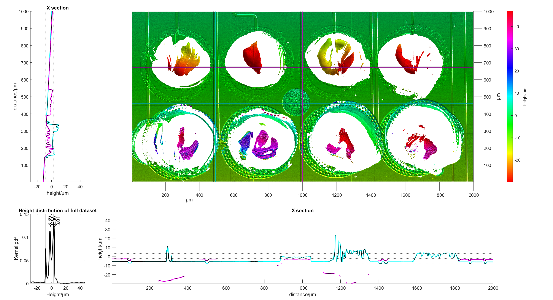
68
Pad 1:
Notes:
A72
Need to check between unbonded and compressed strip, whats the change in gold height.

Slide 16
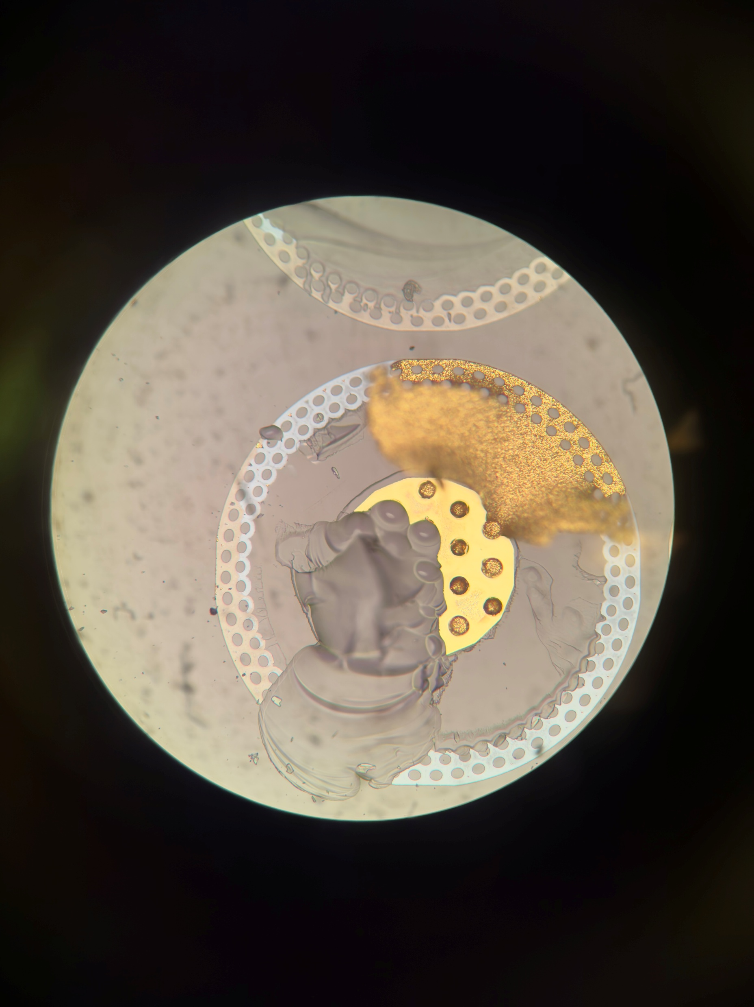
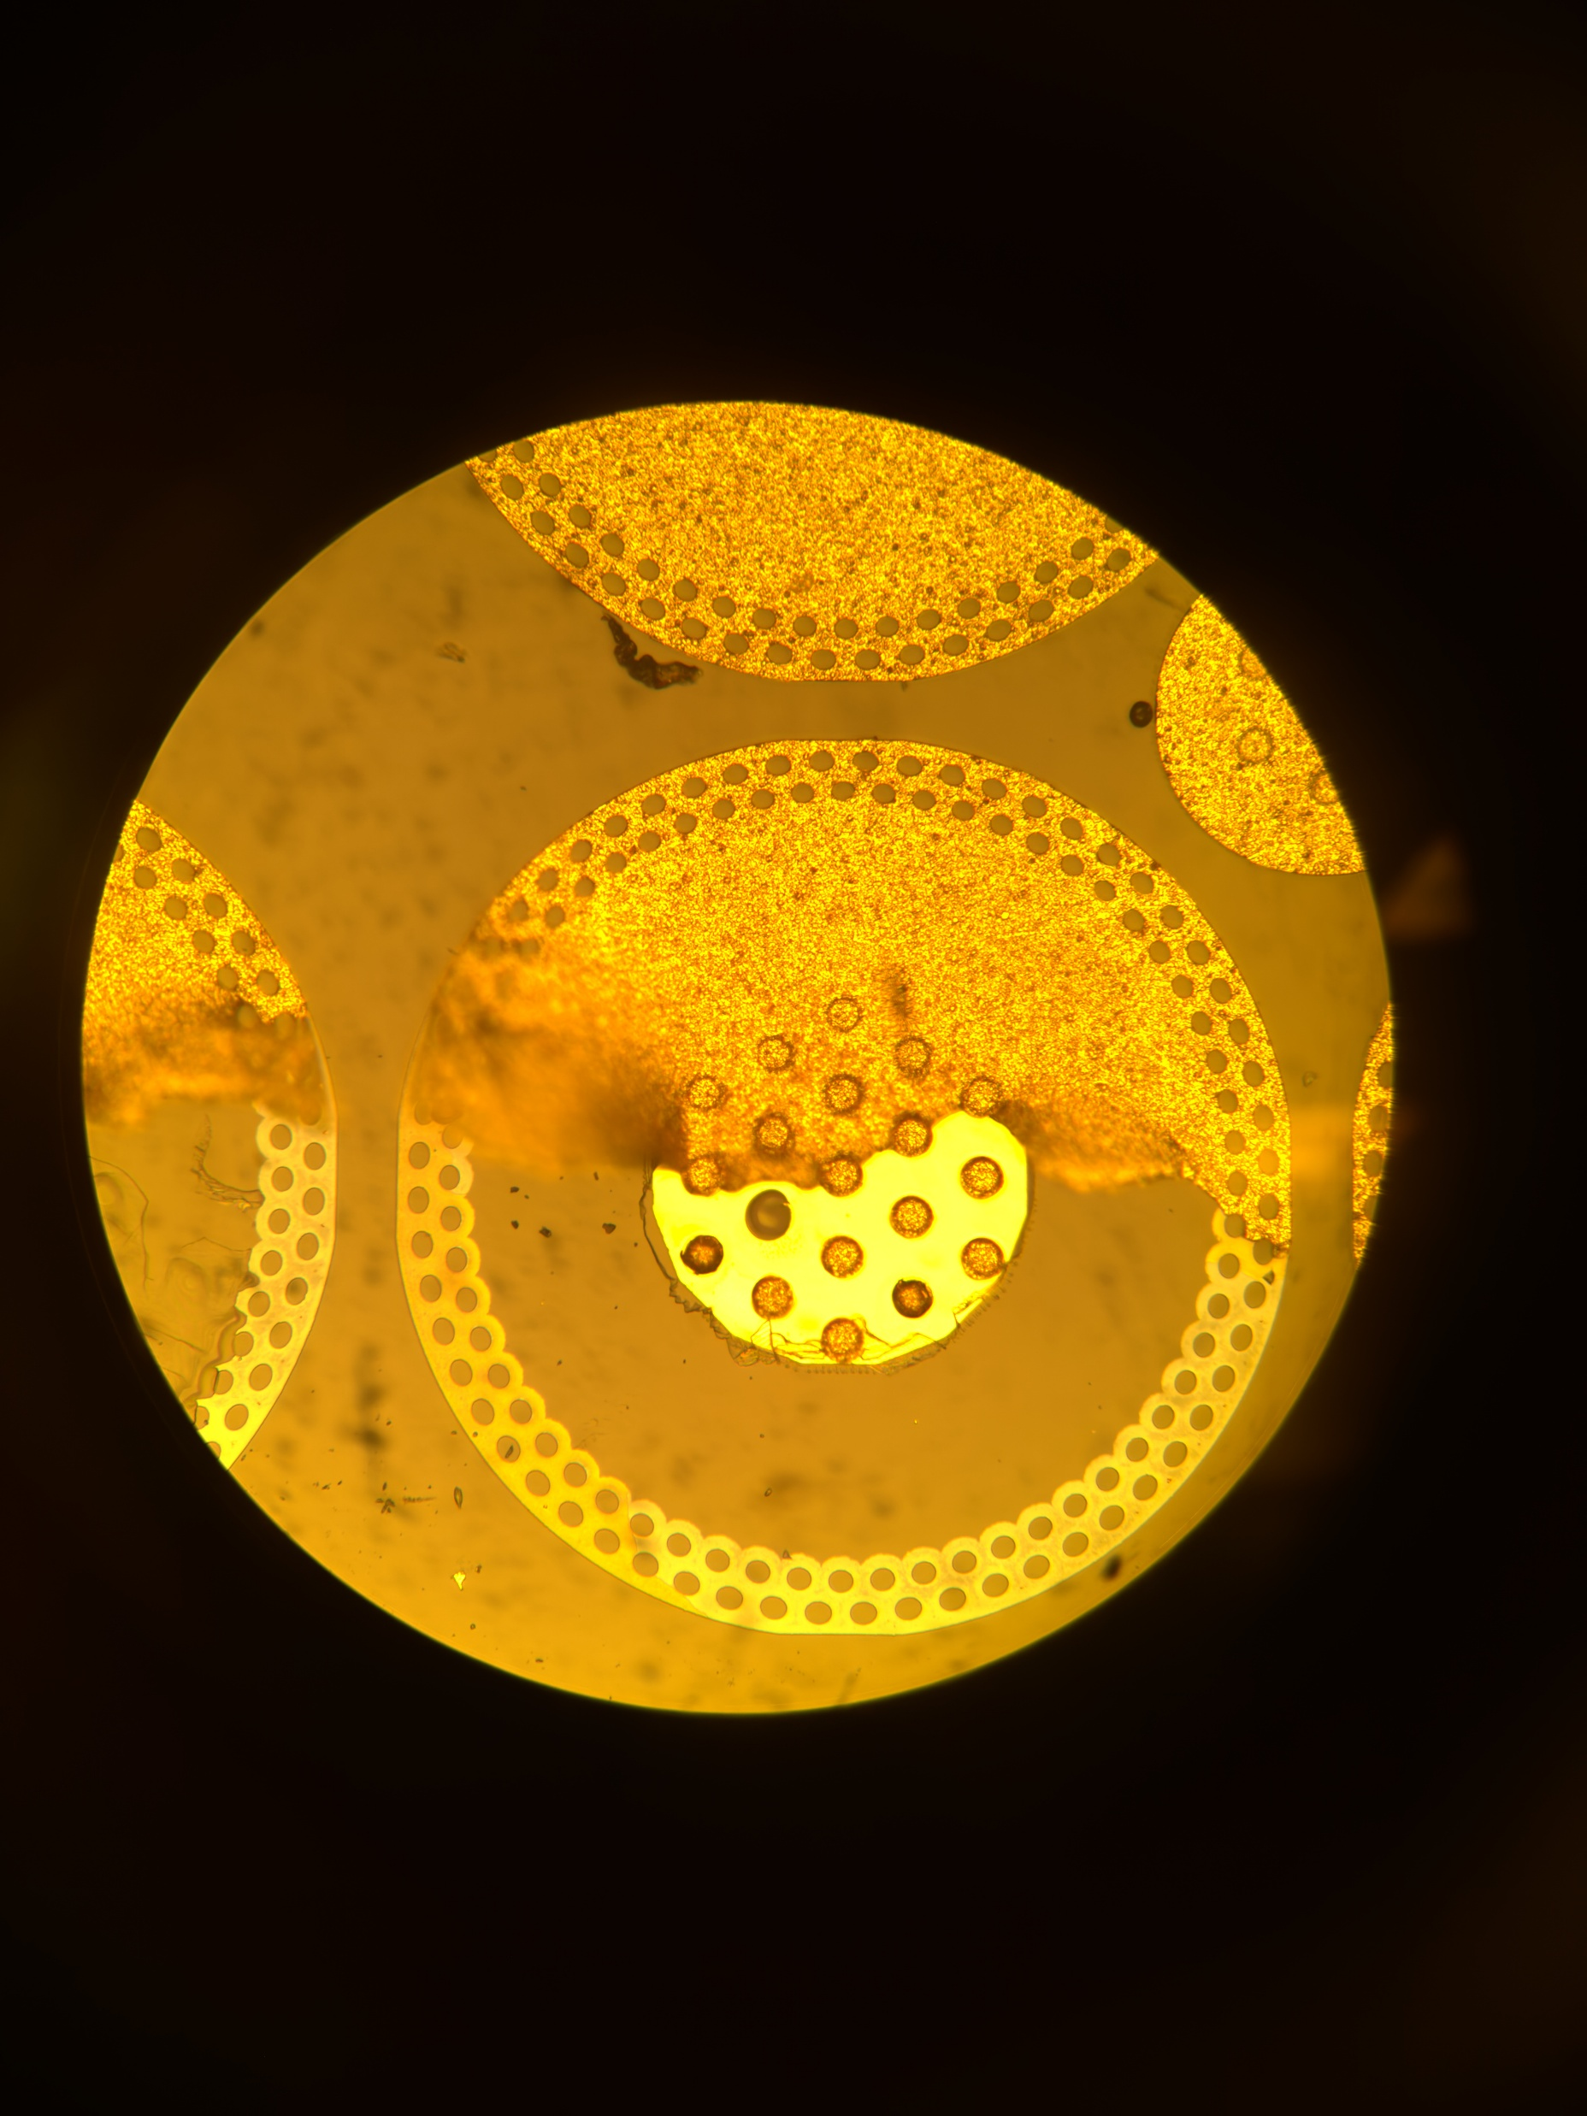
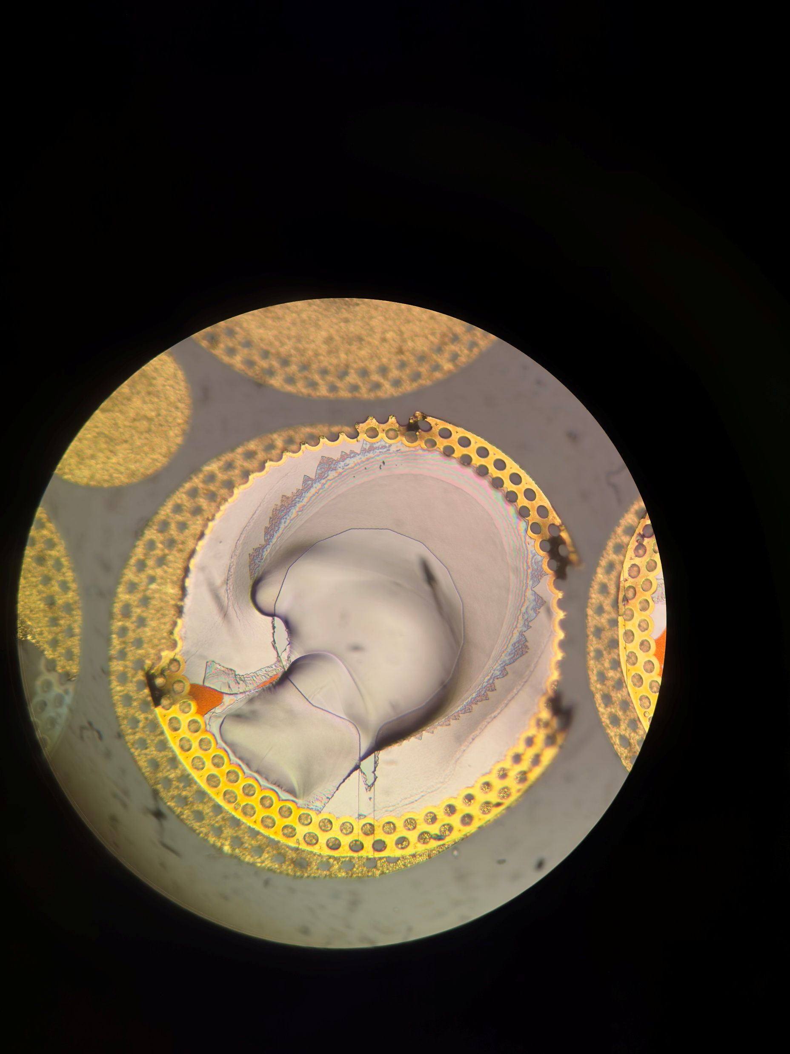
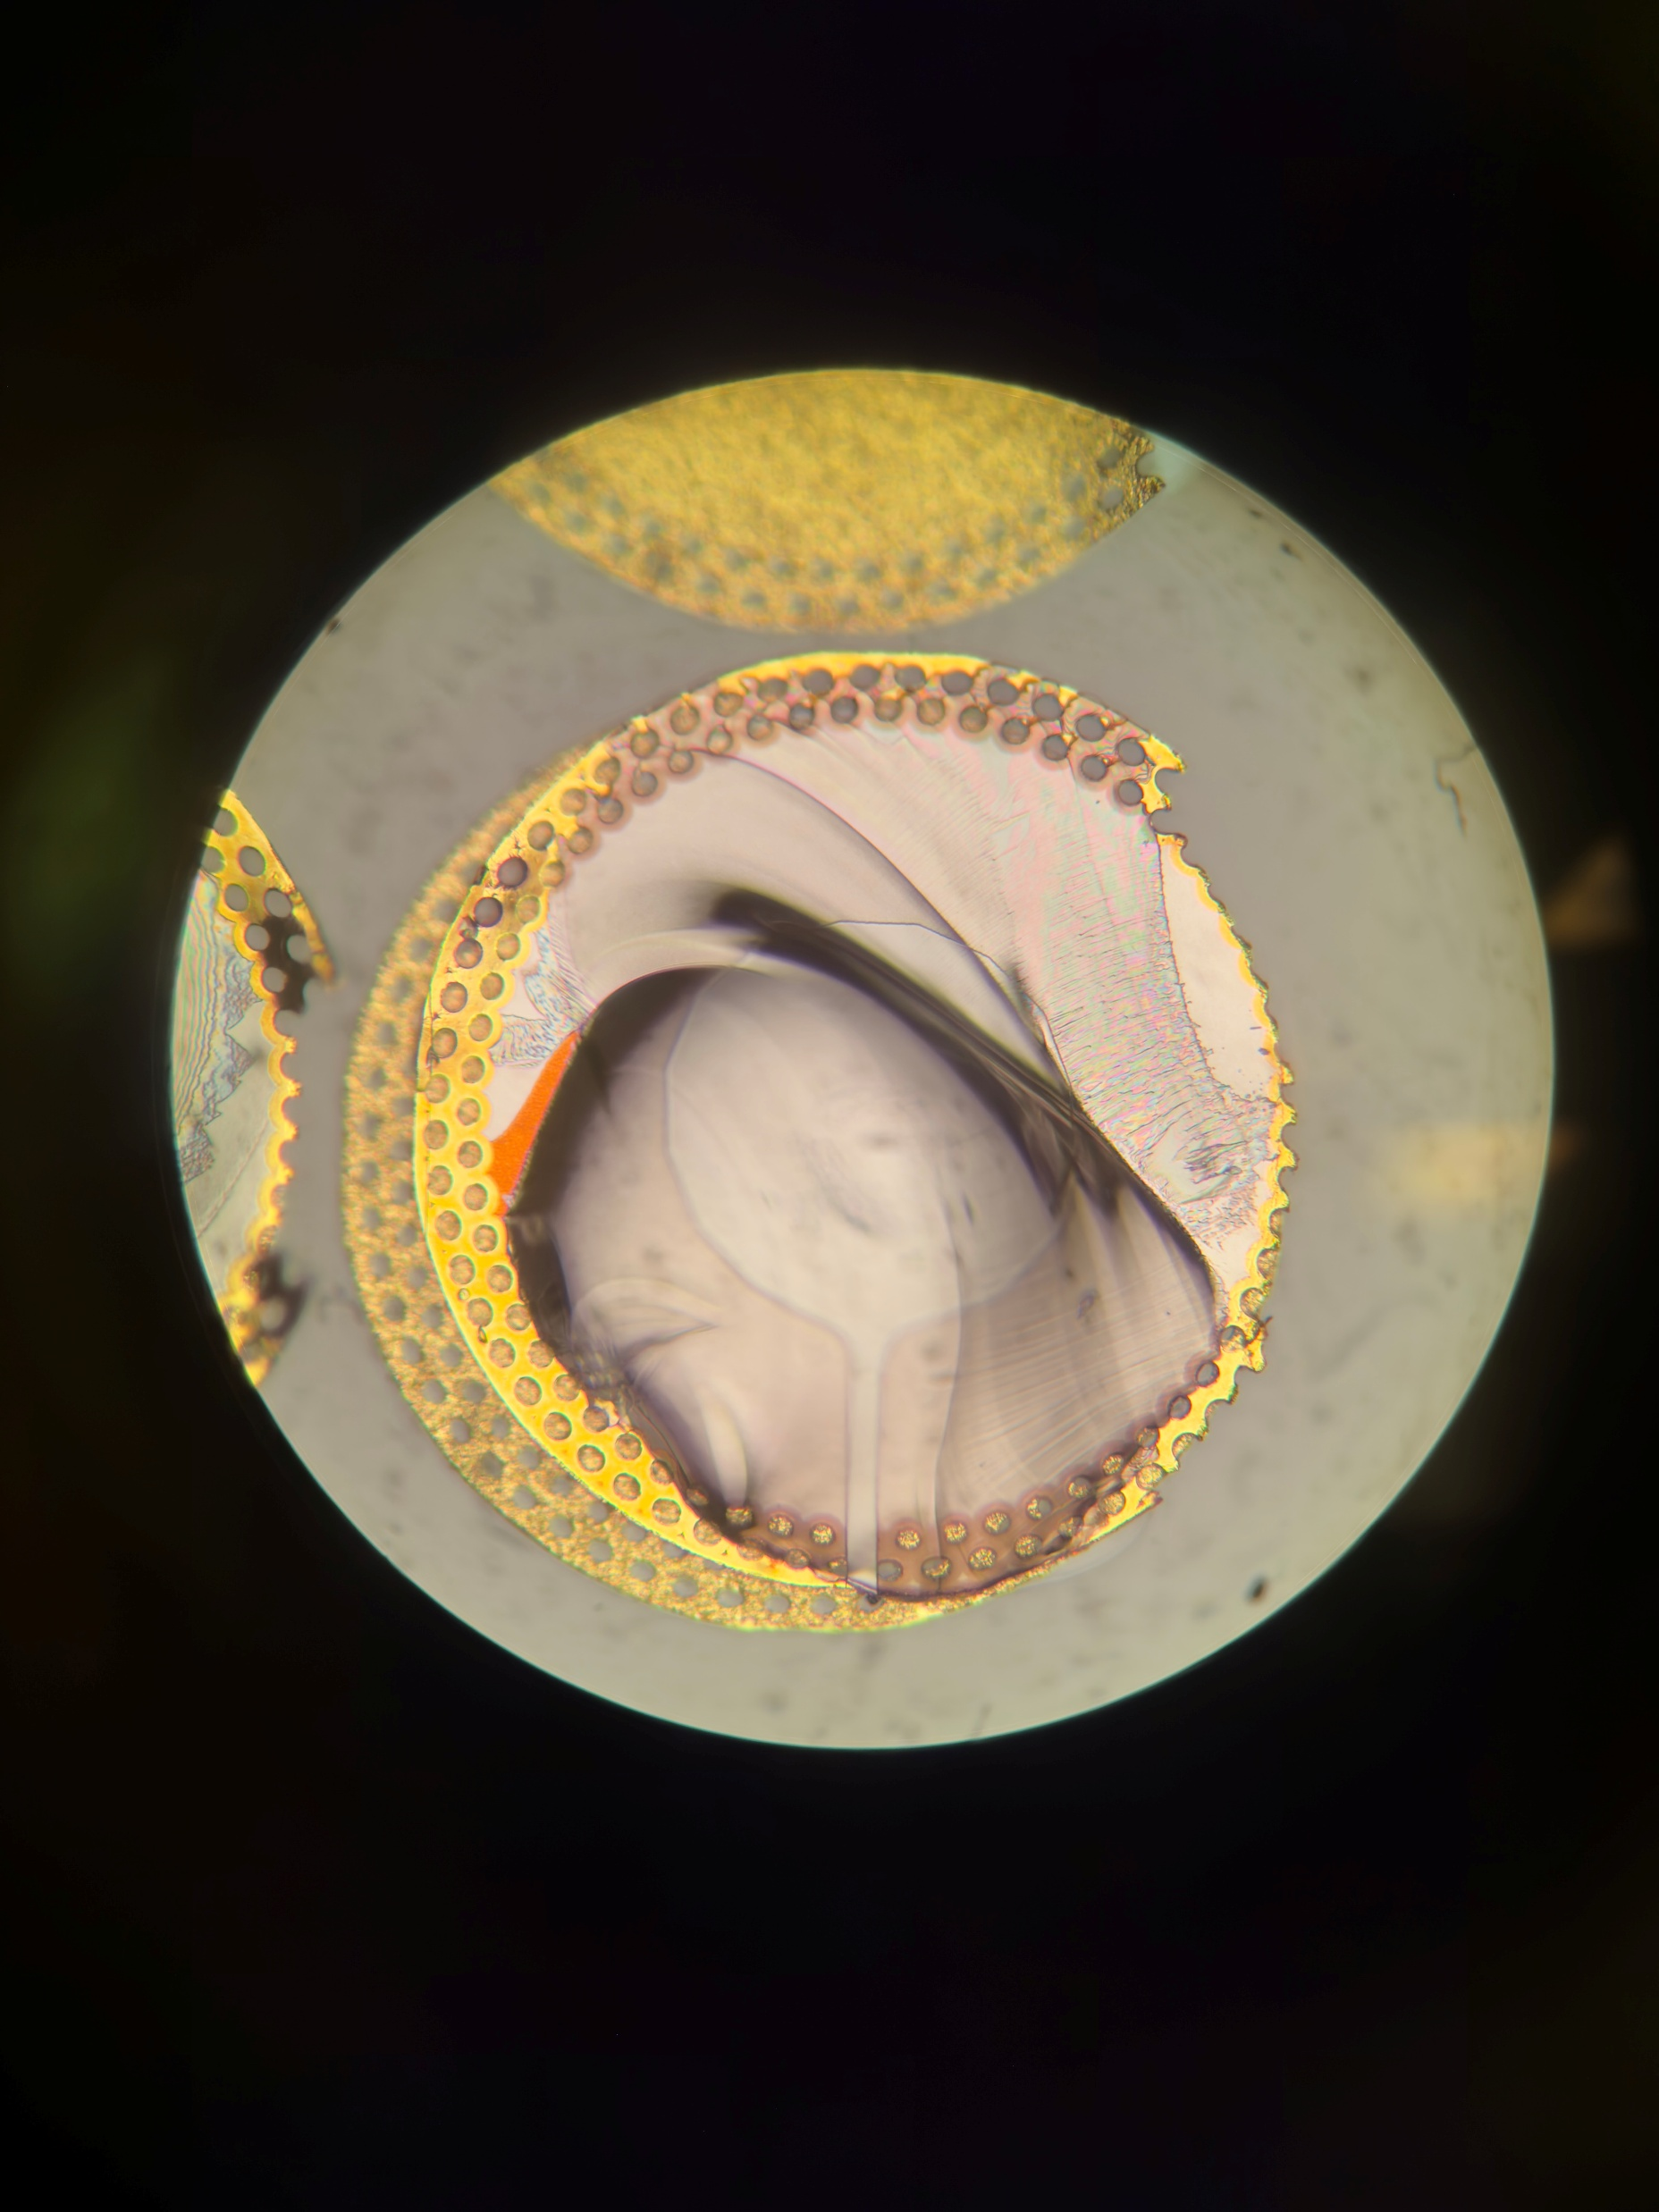
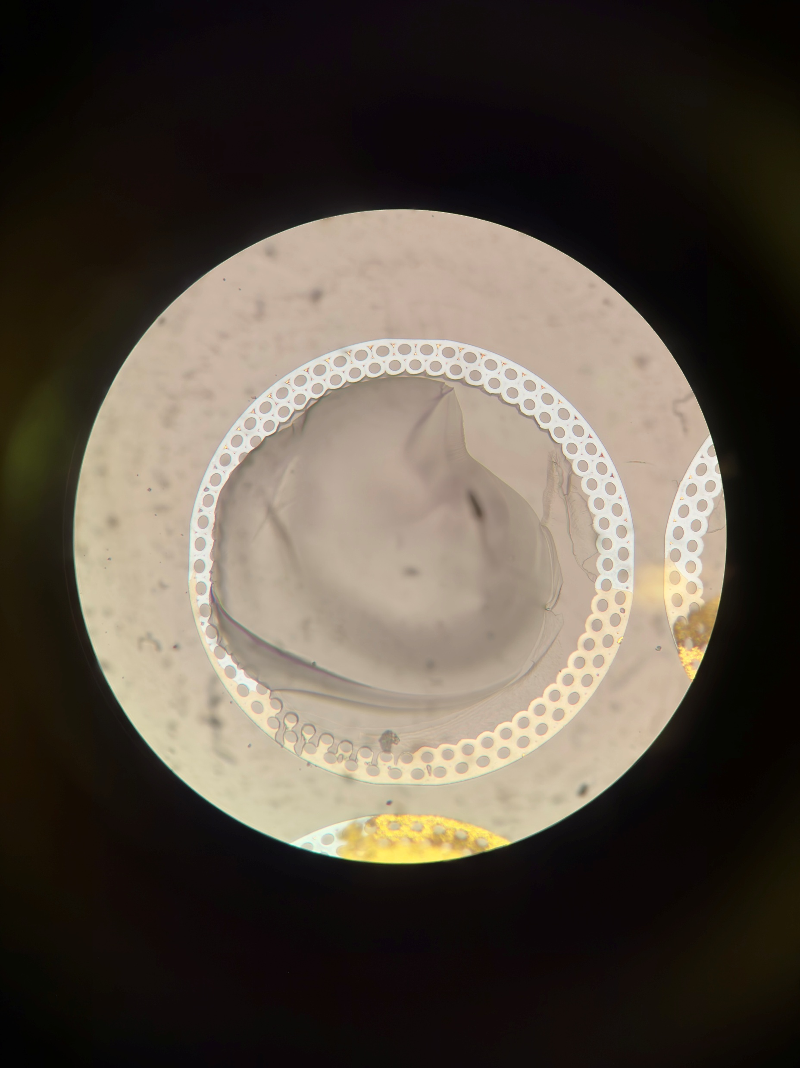
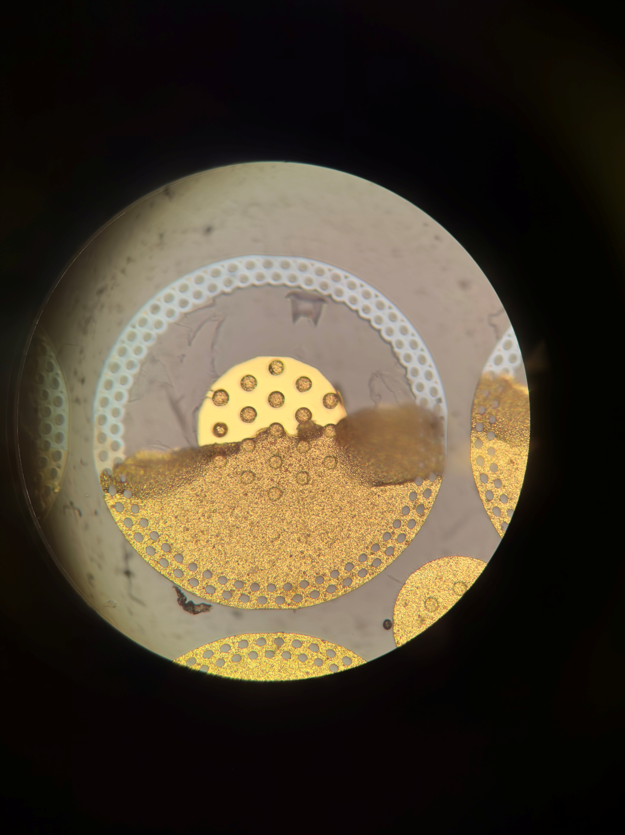
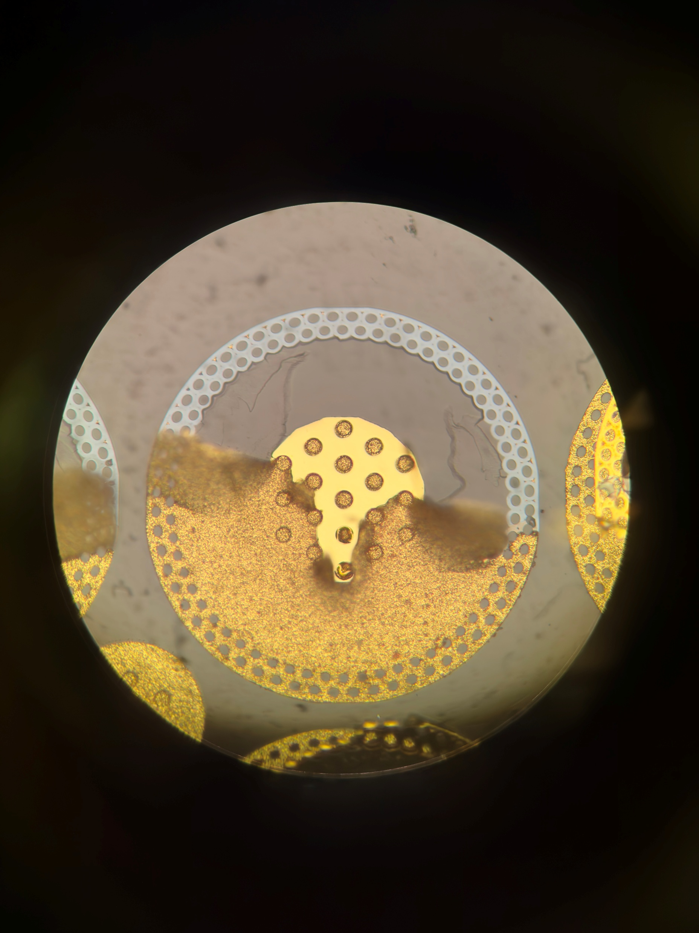
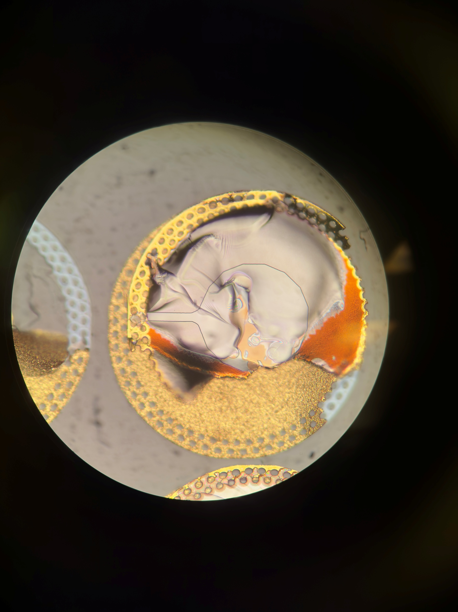
68 Farside
Pad 1:
Opposite side Glass failure at the vias.
Center area is still gold? At height of -1um from surrounding area. (PECVD).
Pad failure delamination of gold from PECVD
Can still see where the vias are left in the pad
Notes:
A72
Need to check between unbonded and compressed strip, whats the change in gold height.

Slide 17

68 Farside Pad 1
Pad 1:
Opposite side Glass failure at the vias.
Center area is still gold? At height of -1um from surrounding area. (PECVD).
Pad failure delamination of gold from PECVD
Can still see where the vias are left in the pad
Notes:
A72
Need to check between unbonded and compressed strip, whats the change in gold height.

Slide 18
A
A
C
C
B
B
D
D

Slide 19


68 Farside Pad 3,4
Tearing of pad at the outer edge,
Glass failure purely inside the pad
Gold-gold bonds held across almost all of contact region.
Notes:
A72
Need to check between unbonded and compressed strip, whats the change in gold height.

Slide 20
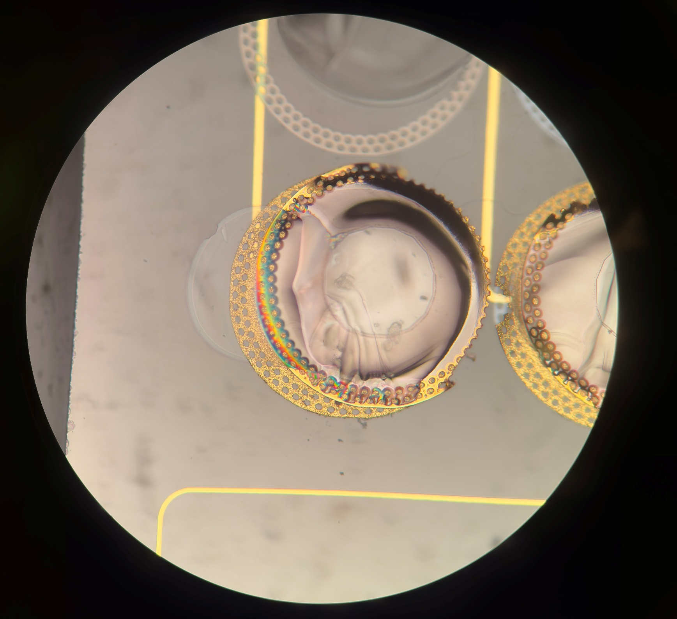
68 Nearside Pad 4:
Iridescence
Always occurs along edge of Pads at the gold-PECVD layer,
Maybe due to delamination of the PECVD causing refraction ?
In this case, there is an area of glass that was removed as well, larger than the pad indicating that this failure occurred during the pull test
Notes:
A72
Need to check between unbonded and compressed strip, whats the change in gold height.

Slide 21
Summary
Majority of failures are glass failures – due to formation of fractures during compression bonding.
However multiple other modes of failure were observed as well
Titanium-glass
Gold-gold
Gold-PECVD
Most common (outside of glass failure) is gold-PECVD
Notable failure is the portion where the vias pulled out a portion of the glass – this is the type of failure which requires the most force to break
Questions about the titanium and gold(?) layer seen
What is causing the different colours?
Does it help explain the iridescence?

Slide 22
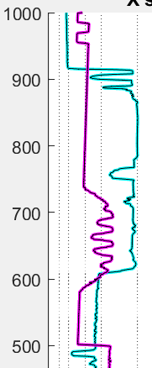
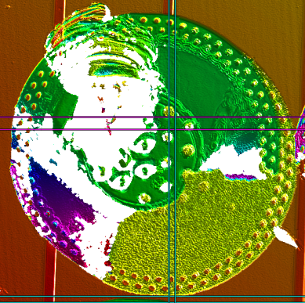
Notes:
Difference in height of 0.2um.
In profilometer, grey part is lower than the brown part
From microscope, grey part is covered by layer of PECVD.
This means that in the stack of
Gold
PECVD
titanium
Glass
Since grey part is lower, this means that then in the stack, it is higher up.
So the grey part is above the brown part in the stack???
Grey part that is seen there is not the bottom most layer – that is still on the corresponding pad.
Grey is the area of the pad before the top most layer of gold.

Slide 23
